Slide 1
Genetics 101: Gaining Understanding of Genomics in Research
Brittany Butts
August 16 – 17, 2022

Slide 2
Disclosures
Learner Outcome: After attending both half-day sessions, participants will have a general understanding of the role of genetics in human health and disease and research applications geared towards improving clinical practice.
Nursing Continuing Professional Development: 7.5 NCPD contact hours will be provided.
Participants must attend at least 90% of both half-day sessions and complete an evaluation survey to receive continuing nursing professional development contact hours.
UNC Charlotte School of Nursing is approved as a provider of nursing continuing professional development by the North Carolina Nurses Association, an accredited approver by the American Nurses Credentialing Center’s Commission on Accreditation.
The evaluation survey link will be sent to participants after the event is completed. The certificate will be attached to the end of the survey.

Slide 3
Part II: Using Genetics in Research
Genome-wide association studies
Gene expression studies
Epigenetics
Accessing genetic applications in your research

Slide 4
Discussion: What was most memorable about what we covered yesterday?

Slide 5
Discussion – A Quick Review
You are working with a man who has been diagnosed with Huntington disease, an autosomal dominant disorder. In describing the disease to him, the doctor tells him that this disease interferes with the genetic control of cellular function.
a. His 15-year-old son is confused by how genes control the function of the cell. How would you explain this to him in a way he could understand?
b. After your explanation, the son asks why DNA repair mechanisms failed for his father. How would you explain this further?

Slide 6
Discussion – A Quick Review
DNA is a stable molecule that contains the information each cell needs to do its job. DNA can be arranged into groups known as genes that “tell” the cell what to do by providing a “map.” The genome or total genetic content is distributed in chromosomes. Through a process known as transcription and then translation, this DNA sequence is turned into proteins.
Rarely, accidental errors in duplication of DNA occur. These errors are called mutations. Mutations result from the substitution of one base pair for another, the loss or addition of one or more base pairs, or rearrangements of base pairs. Many of these mutations occur spontaneously, whereas others occur because of environmental agents, chemicals, and radiation. Often there is no known reason.

Slide 7
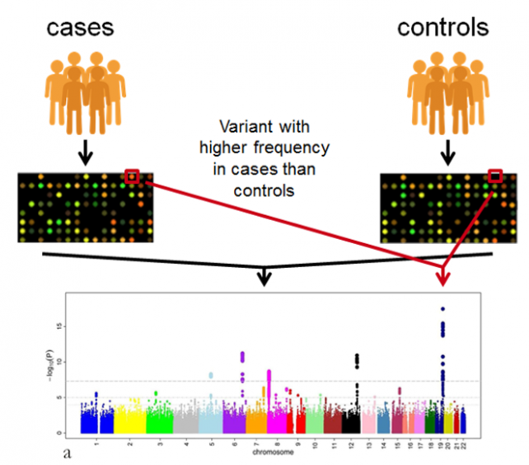
Genome-wide Association Studies (GWAS)
Used to identify genomic variants that are statistically associated with a risk for a disease or a particular trait
Uses a case-control model
Examines the entire genome of a large group of people
Looks for differences in SNPs
Single nucleotide polymorphisms

Slide 8
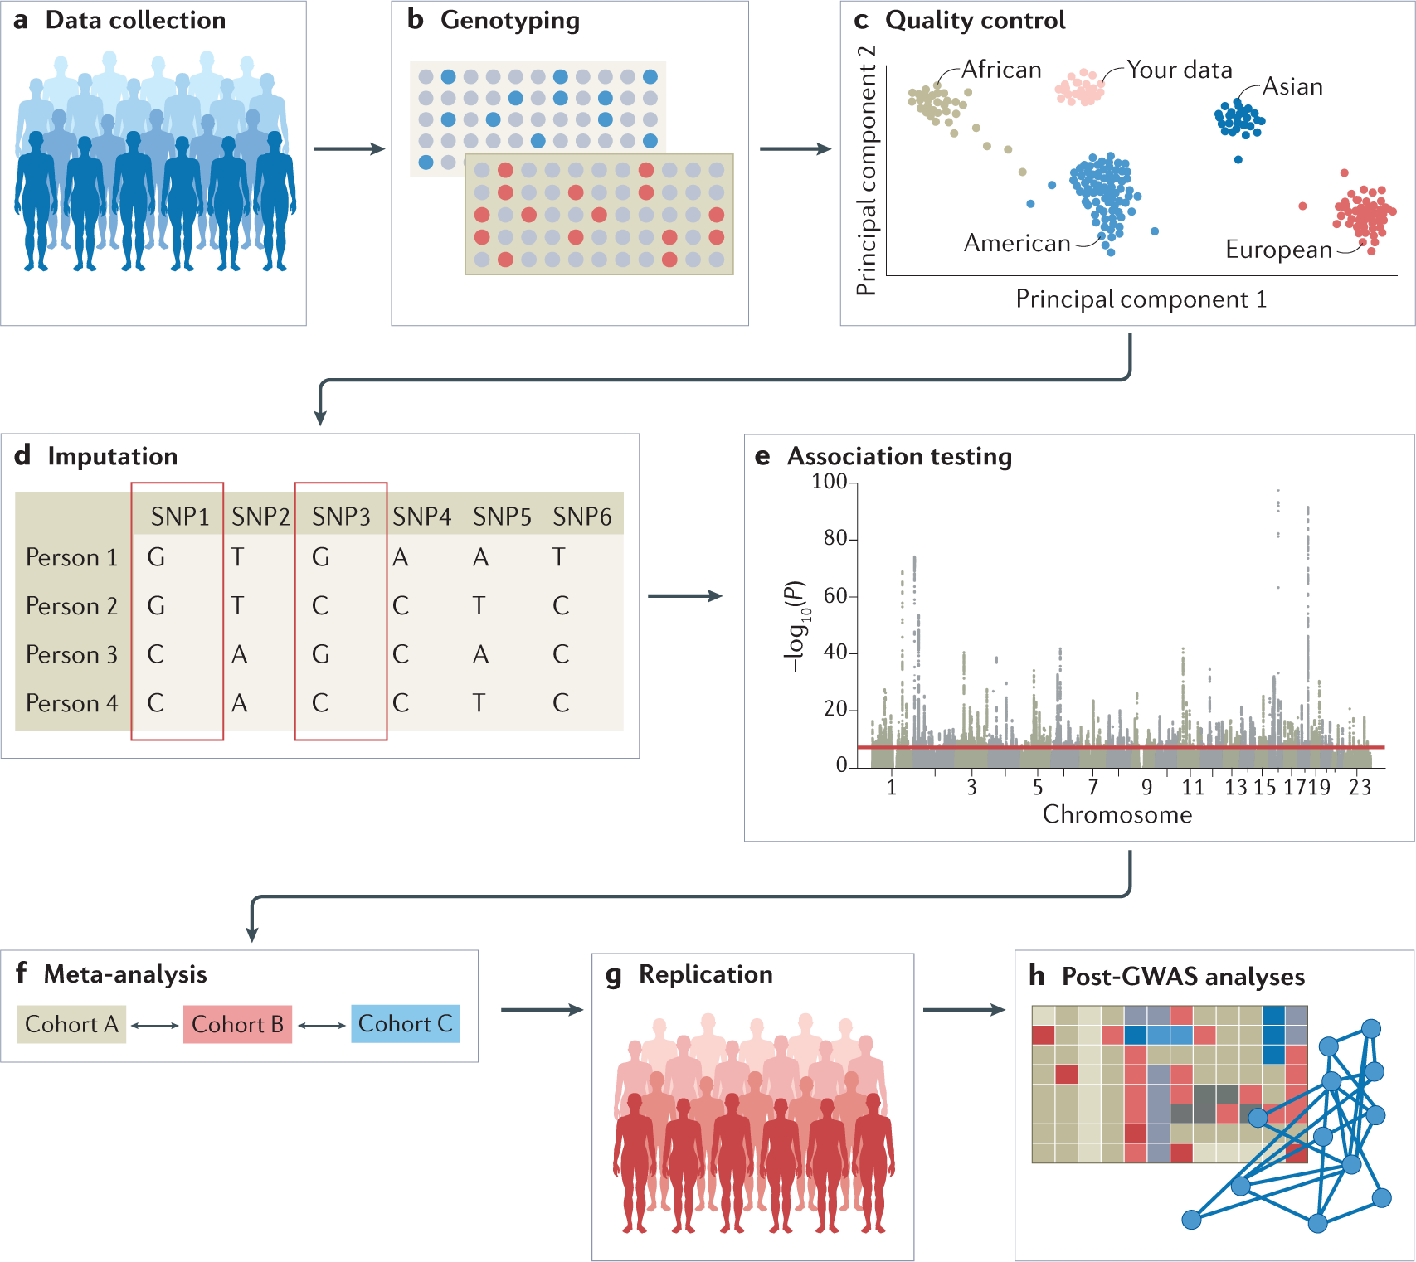

Slide 9
Benefits of GWAS
Have been very successful in identifying novel associations between SNPs and traits
Can lead to the discovery of novel biological mechanisms
Findings have diverse clinical applications
Can provide insight into ethnic variation of complex traits
Relevant to the study of low- frequency and rare variants
Can be used to identify novel single-gene disease genes
Data are used for multiple applications beyond gene identification
Data are easily shared, and publicly available data facilitates novel discoveries
We now have reliable and cost-effective SNP arrays

Slide 10
Limitations of GWAS
Epistasis: One gene could mask the effect of another
Penalized by an important multiple testing burden
Explain only a modest fraction of the missing heritability
Do not necessarily pinpoint causal variants and genes
Cannot identify all genetic determinants of complex traits
Have been largely unsuccessful in detecting epistasis in humans
Can be confounded by population stratification—systematic ancestry differences between cases and controls
Limited clinical predictive value

Slide 11
Exemplar: Park et al., 2022 Translational Genomic Research: The Association between Genetic Profiles and Cognitive Functioning or Cardiac Function Among Breast Cancer Survivors Completing Chemotherapy
What was their question?
What methods were used?
Why did they choose these methods to answer their question?
How easy were the results to interpret?

Slide 12
Background
Park et al., 2022
Chemotherapy-associated cognitive impairment has been found in 13-70% of breast cancer survivors
Breast cancer survivors often experience symptoms – pain, fatigue, sleep disturbance, depression
Thought to be related to genetics
Chemotherapy-induced cardiac dysfunction occurs in ~10% of breast cancer survivors
Hypothesize that genetic risk factors may play a role
It is also thought that genetic risk factors may play a role in cognitive impairment after chemotherapy

Slide 13
Background
Park et al., 2022
A number of candidate genes have been identified related to post-chemotherapy complications of cognitive impairment and cardiac dysfunction
11 genes (12 SNPs) thought to relate to cognitive function
4 genes (5 SNPs) thought to be related to cardiac function
Purpose: explore the relationship between SNPs in candidate genes and cognitive and cardiac functioning among breast cancer survivors with previous chemotherapy.

Slide 14
Methods – Study Sample
Park et al., 2022
Sub-study using baseline data from a larger R01 intervention study
Study population
Inclusion: women ≥ 21 years diagnosed with stage I, II, or III breast cancer who completed chemotherapy (+/- radiation), are within 5 years post-treatment, and met cognitive impairment screening criteria
Have you had difficulty in concentrating on things, like reading a newspaper or watching television? Have you had difficulty remembering things?
Exclusion: severe psychiatric diagnosis, stage 0 or IV breast cancer, history of other cancer, metastasis, neuro disorder, TBI

Slide 15
Methods – Variables and Measures
Park et al., 2022
Demographics and clinical history
Cognitive battery
Visuospatial memory – Brief Visuospatial Memory Test-Revised
Verbal memory – Hopkins Verbal Learning Test-Revised
Logical memory – Logical Memory I and II subscales from Wechsler
Attention/Concentration – Digit Span, Trails I
Executive function – Trails II, Stroop
Verbal fluency – Controlled Oral Word Association Test, Wechsler Test of Adult Reading
Perceived cognitive performance – Functional Assessment of Cancer Therapy-Cognitive Function
Cardiac measures – SBP, DBP, HR, RR, O₂

Slide 16
Methods – Genotyping
Park et al., 2022
Used putative candidate genes from literature implicated in pathways related to outcomes of interest (cognitive function, cardiac function)
Selected 14 genes (16 SNPs) based on associations with outcomes of interest
DNA extracted from peripheral blood cells or buccal cells
Used PCR to genotype allele variants for each candidate gene
https://www.thermofisher.com/us/en/home/life-science/pcr/real-time-pcr/real-time-pcr-learning-center/real-time-pcr-basics/how-taqman-assays-work.html

Slide 17
Results
Park et al., 2022
Participants
N=212 from parent study, but a number were excluded. Final sample included:
N=207 with genetic data
Excluded non-white participants due to differential genotype distribution, leaving n=151 (??)
For cardiac data n=28

Slide 18
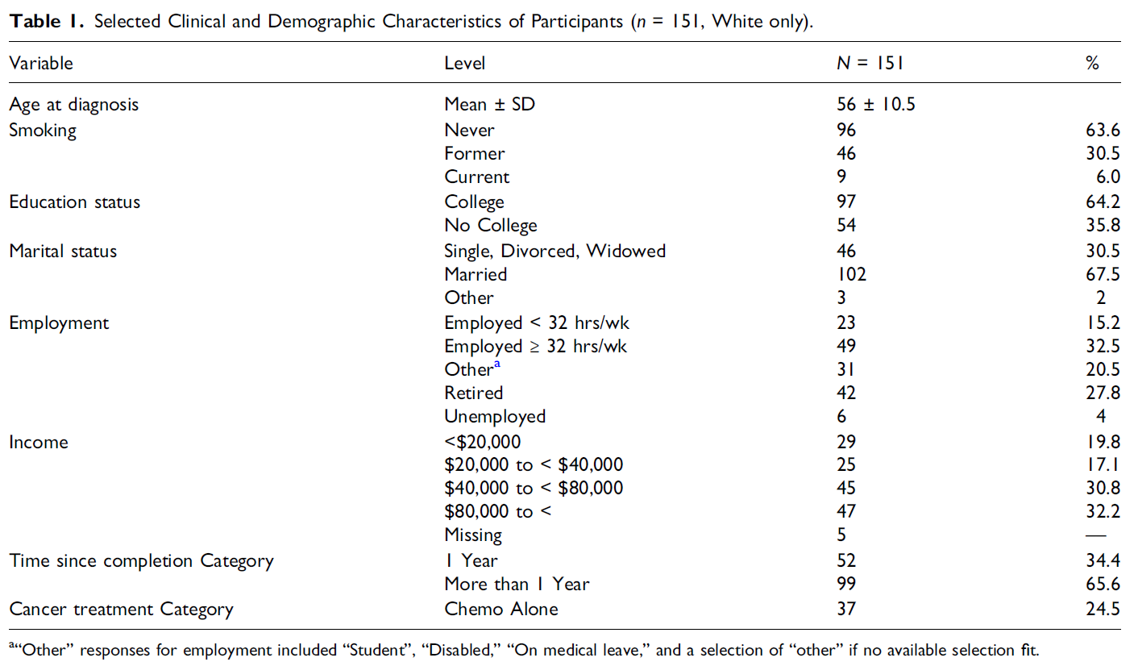
Results
Park et al., 2022

Slide 19
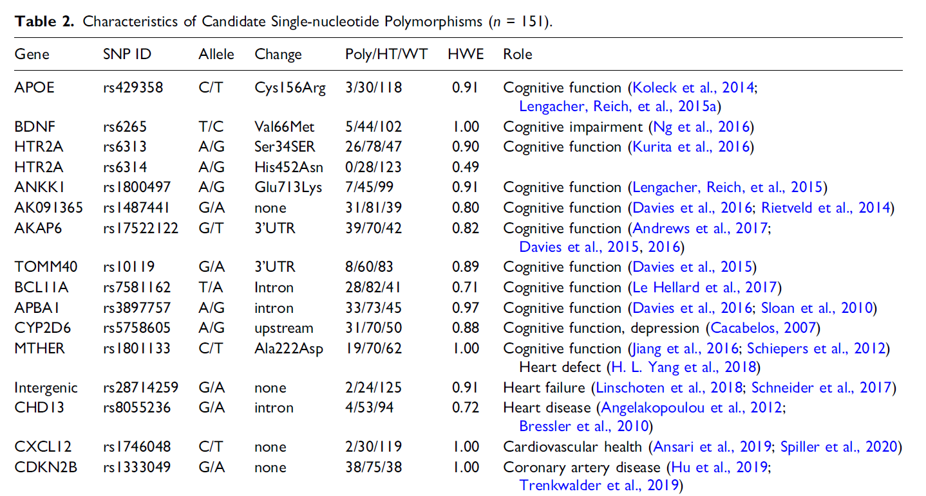
Results
Park et al., 2022

Slide 20
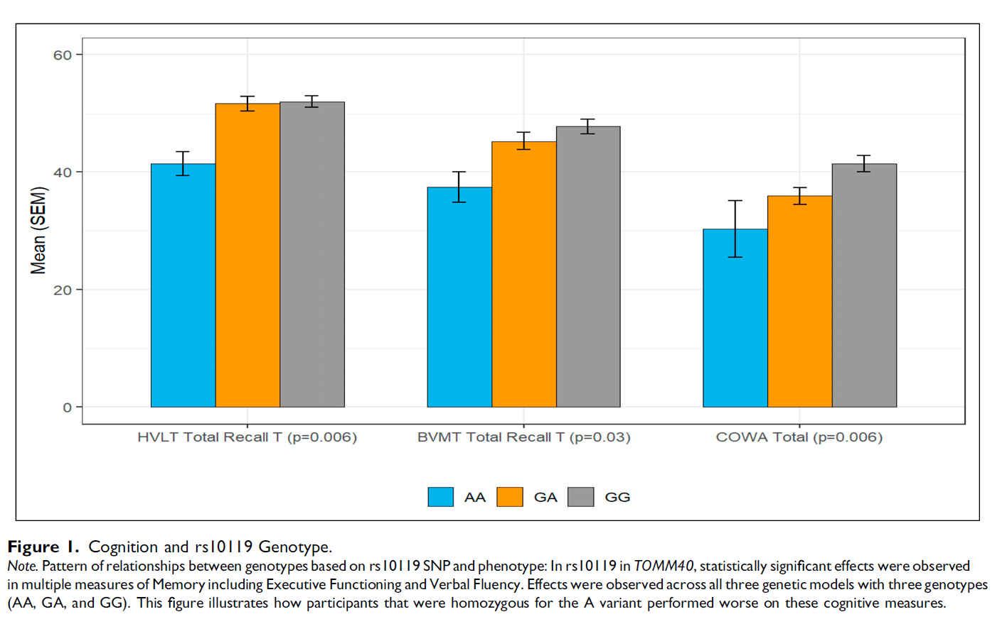
Results
Park et al., 2022
3 SNPs from APOE, ANKK1, and TOMM40 were most significant with measures of cognitive function

Slide 21
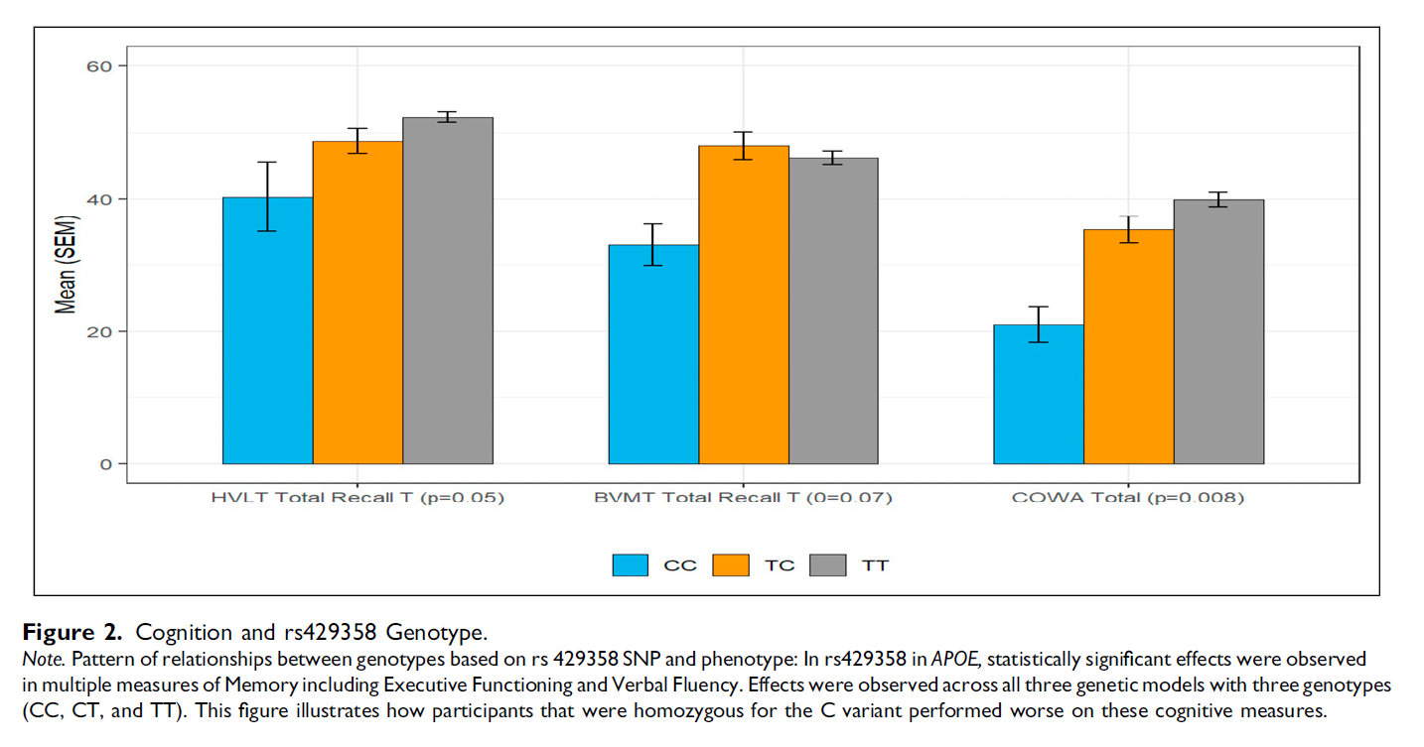
Results
Park et al., 2022
3 SNPs from APOE, ANKK1, and TOMM40 were most significant with measures of cognitive function

Slide 22
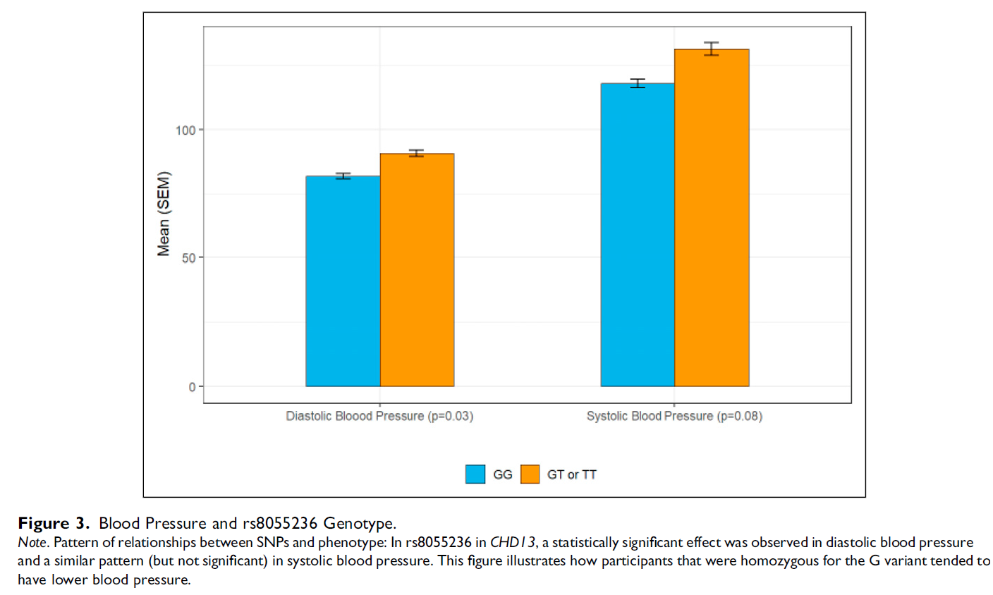
Results
Park et al., 2022
2 SNPs from SDH13 and MTHFR had potential relationships with cardiac measures

Slide 23
Discussion
Park et al., 2022
APOE SNP rs420358 associated with decline in cognitive function
APOE transports lipids, fat-soluble vitamins, and cholesterol into the lymph system and then into the blood. It is synthesized principally in the liver but has also been found in other tissues such as the brain, kidneys, and spleen.
ANKK1 SNP causes an AA change from Glu to Lys at codon 713, reducing D2 receptor binding and glucose metabolism in the brain
This variant associated with cognitive impairment
TOMM40 encodes mitochondrial outer membrane complex involved in protein transport
SNPs associated with age-related cognitive decline

Slide 24
Discussion
Park et al., 2022
CDH13 (cadherin-13)
negative regulator of axon growth during neural differentiation
protects vascular endothelial cells from apoptosis due to oxidative stress, and is associated with resistance to atherosclerosis
essential for cognitive flexibility function and correct memory formation
MTHFR (methylenetetrahydrofolate reductase)
key regulatory enzyme in folate and homocysteine metabolism
SNP rs1801133 leads to reduced enzyme activity and extracellular matrix remodeling
Has been associated with congenital heart defects

Slide 25
Study Limitations
Park et al., 2022
Exclusion of all non-white participants
Mechanisms/pathways of SNPs did not seem to be well thought out before analyses
Small sample size – especially for cardiac analyses
Cardiac measures did not measure up to a reasonable expectation of ‘cardiac function’

Slide 26
Exemplar: Park et al., 2022 Translational Genomic Research: The Association between Genetic Profiles and Cognitive Functioning or Cardiac Function Among Breast Cancer Survivors Completing Chemotherapy
What was their question?
What methods were used?
Why did they choose these methods to answer their question?
How easy were the results to interpret?

Slide 27
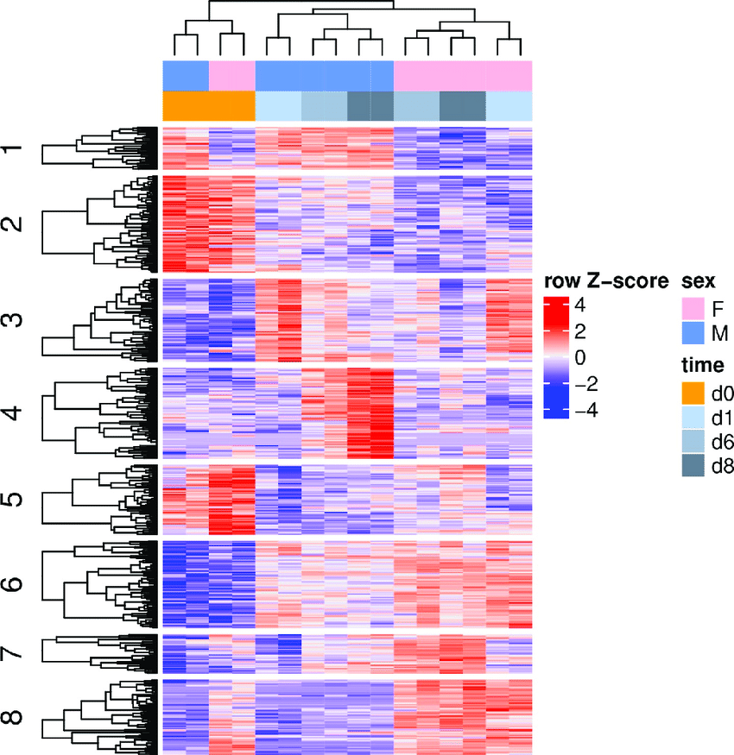
Gene Expression Studies
Transcripts – mRNA
Proteins
Look at phenotype rather than genotype
Gene expression analysis provides valuable insight into the role of differential gene expression in normal biological and disease processes
Allows for the identification and verification of biomarker signatures
Cluster analysis of differential gene expression
Pearson, G, et al. (2019). PLOS ONE. 14. e0219723.
10.1371/journal.pone.0219723.

Slide 28
Exemplar: Dungan et al. 2009 Altered Beta-2 Adrenergic Receptor Gene Expression in Human Clinical Hypertension
What was their question?
What methods were used?
Why did they choose these methods to answer their question?
How easy were the results to interpret?

Slide 29
Background
Dungan et al. 2009
Beta-2 adrenergic receptor (ARB2) – binding causes vasodilatation through endothelium-dependent and -independent mechanisms
Impaired ARB2 function may lead to hypertension
To date, no genetic variants have been associated with hypertension
However, gene expression may vary
Example – dietary NaCl intake mediates ARB2 expression

Slide 30
Background
Dungan et al. 2009
Note: expression of genes will vary by cell type, so it is important to consider the appropriate sample type
This can be a major limitation to gene expression research
Purpose: explore ARB2 mRNA using internal mammary artery samples in CABG patients with and without hypertension

Slide 31
Methods
Dungan et al. 2009
Participants:
English speaking
Aged 21-70 years
Scheduled for CABG using internal mammary artery
Sample size: N=51, 17 normotensive and 24 hypertensive
Study design: case-control

Slide 32
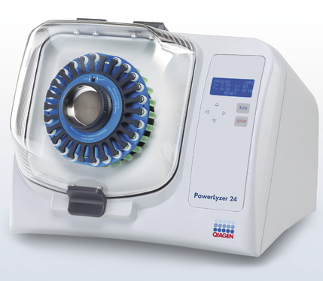
Methods – Tissue collection and processing
Dungan et al. 2009
Discarded arterial tissue was collected and stored in RNAlater solution (helps preserve RNA in frozen tissue). I assume tissues were stored in freezer, but doesn’t say.
RNA isolation: remove tissue from solution, freeze with liquid nitrogen, and grind into a powder with mortar and pestle
You then add a solution and use a homogenizer to break open the cells, freeing the contents
The RNA is then found in the liquid component (supernatant)

Slide 33
Methods – Tissue collection and processing
Dungan et al. 2009
RNA is then extracted
Used reverse transcription to copy RNA code into DNA code
Real-time PCR was used to quantify DNA using TaqMan assay
Note: RT-PCR is used for quantification, so data generated are all compared against a calibration sample (usually a healthy control if possible) and against an endogenous control to get a standard relative quantity that can be compared across the sample.

Slide 34
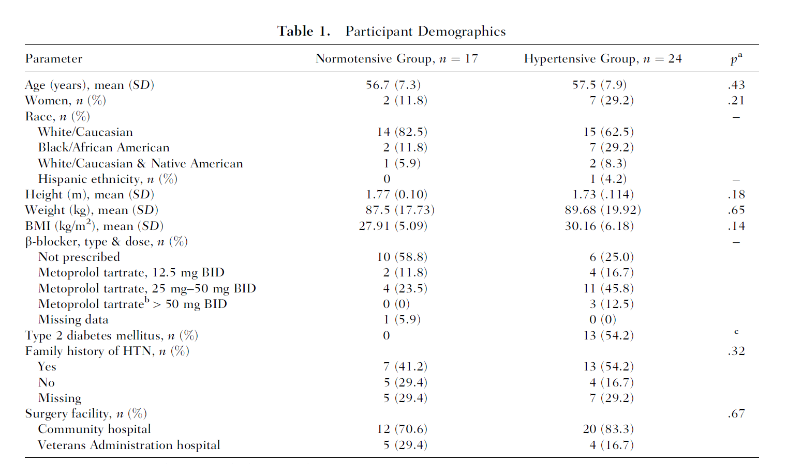
Results
Dungan et al. 2009

Slide 35
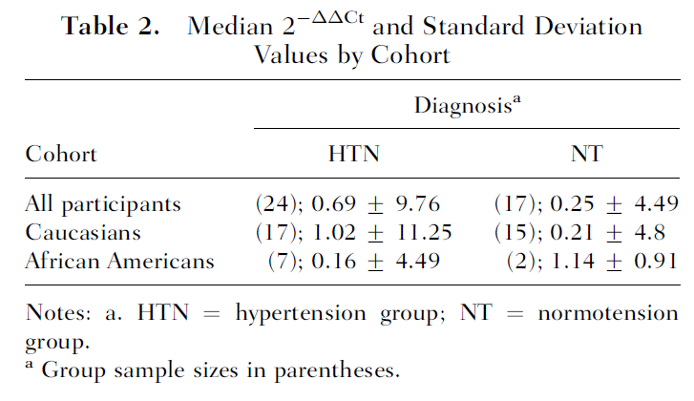
Results
Dungan et al. 2009
ARB2 gene expression was significantly lower in hypertensive participants (2.76-fold, p=.035)
Higher number = more cycles to reach threshold, so lower number of transcripts (less mRNA present)
There also were race differences, but these data were not well presented
Note: low # of self-reported Black/African American participants, and Native Americans were grouped with ‘Caucasian’

Slide 36
Discussion
Dungan et al. 2009
Preliminary support for ARB2 gene expression contributing to impaired vasorelaxation in hypertension
Strengths and Limitations:
Using vascular tissue is a strength; small samples size is limitation
Small sample size also limits sample diversity, leading to inappropriate analyses
mRNA measured here is a snapshot, perhaps steady state levels, and not linked with adrenergic signaling. Although one could hypothesize that in hypertension steady state levels might be higher.
ARB2 protein was not measured, so not know the full extent of gene expression
This paper is from 2009. Hypertension guidelines have been updated.

Slide 37
Epigenetics – Types of Modifications

Slide 38
DNA Methylation
Addition of a methyl group to DNA
Typically, this group is added to specific places on the DNA, where it blocks the proteins that attach to DNA to “read” the gene
This methyl group can be removed through a process called demethylation
Typically, methylation turns genes “off” and demethylation turns genes “on”

Slide 39
Histone modification
DNA wraps around proteins called histones
DNA wrapped tightly around histones cannot be accessed by proteins that read the gene
Some genes are wrapped around histones and are turned “off” while some genes are not wrapped around histones and are turned “on”
Chemical groups can be added or removed from histones and change whether a gene is unwrapped or wrapped (“on” or “off”)

Slide 40
Non-coding RNA
Non-coding RNA helps control gene expression by attaching to coding RNA, along with certain proteins, to break down the coding RNA so that it cannot be used to make proteins.
Non-coding RNA may also recruit proteins to modify histones to turn genes “on” or “off.”

Slide 41
Why Study Epigenetics in Research?
Epigenetics control gene expression
Many epigenetic mechanisms are modifiable
Epigenetics change with aging, both as part of normal development and aging and in response to your behaviors and environment

Slide 42
How Can Epigenetics Change?
Epigenetics and Development
Epigenetic changes begin before you are born. All your cells have the same genes but look and act differently. As you grow and develop, epigenetics helps determine which function a cell will have, for example, whether it will become a heart cell, nerve cell, or skin cell
Example: Nerve cell vs. Muscle cell
Your muscle cells and nerve cells have the same DNA but work differently. A nerve cell transports information to other cells in your body. A muscle cell has a structure that aids in your body’s ability to move. Epigenetics allows the muscle cell to turn “on” genes to make proteins important for its job and turn “off” genes important for a nerve cell’s job.

Slide 43
How Can Epigenetics Change?
Epigenetics and Age
Your epigenetics change throughout your life. Your epigenetics at birth is not the same as your epigenetics during childhood or adulthood.
Example: Study of newborn vs. 26-year-old vs. 103-year-old
DNA methylation at millions of sites were measured in a newborn, 26-year-old, and 103-year-old. The level of DNA methylation decreases with age. A newborn had the highest DNA methylation, the 103-year-old had the lowest DNA methylation, and the 26-year-old had a DNA methylation level between the newborn and 103-year-old.
1. Heyn H, Li N, Ferreira H, et al., Proc Natl Acad Sci U S A 2012; 109:10522-7

Slide 44
How Can Epigenetics Change?
Epigenetics and Reversibility
Not all epigenetic changes are permanent. Some epigenetic changes can be added or removed in response to changes in behavior or environment.
Example: Smokers vs. non-smokers vs. former smokers
Smoking can result in epigenetic changes. For example, at certain parts of the AHRR gene, smokers tend to have less DNA methylation than non-smokers. The difference is greater for heavy smokers and long-term smokers. After quitting smoking, former smokers can begin to have increased DNA methylation at this gene. Eventually, they can reach levels similar to those of non-smokers. In some cases, this can happen in under a year, but the length of time depends on how long and how much someone smoked before quitting.
McCartney D, Stevenson A, Hillary R, et al., Epigenetic signatures of starting and stopping smoking. EBioMedicine 2018; 37:214-220

Slide 45
Epigenetics and Health
Infections
Germs can change your epigenetics to weaken your immune system. This helps the germ survive.
Example: Mycobacterium tuberculosis
Mycobacterium tuberculosis causes tuberculosis. Infections with these germs can cause changes to histones in some of your immune cells that result in turning “off” the IL-12B gene. Turning “off” the IL-12B gene weakens your immune system and improves the survival of Mycobacterium tuberculosis.
Chandran A, Antony C, Jose L, et al., Mycobacterium Tuberculosis Infection Induces HDAC1-Medicated Suppression of IL-12B Gene Expression in Macrophages. Front Cell Infect Microbiol 2015; 5:90

Slide 46
Epigenetics and Health
Tang Q, Cheng J, Cao X, et al., Clin Epigenetics 2016; 8: 115
Infections
Germs can change your epigenetics to weaken your immune system. This helps the germ survive.
Cancer Certain mutations make you more likely to develop cancer. Likewise, some epigenetic changes increase your cancer risk. For example, having a mutation in the BRCA1 gene that prevents it from working properly makes you more likely to get breast and other cancers. Similarly, increased DNA methylation that results in decreased BRCA1 gene expression raises your risk for breast and other cancers. While cancer cells have increased DNA methylation at certain genes, overall DNA methylation levels are lower in cancer cells compared with normal cells. Different types of cancer that look alike can have different DNA methylation patterns. Epigenetics can be used to help determine which type of cancer a person has or can help to find hard to detect cancers earlier. Epigenetics alone cannot diagnose cancer, and cancers would need to be confirmed with further screening tests.

Slide 47
Epigenetics and Health
Roseboom T., J Endocrinol 2019. 242:T135-T144; Heijmans B, Tobi E, Stein A, et al., Proc Natl Acad Sci U S A 2008; 105: 17046-17049; Tobi E, Lumey L, Talens R, et al., Hum Mol Genet 2009; 18:4046-53; Tobi E, Slieker R, Luijk R, et al., Sci Adv 2018; 4:eaao4364; Dayeh T, Tuomi T, Almgren P, et al., Epigenetics 2016; 7: 482-8; Pidsley R, Dempster E, Troakes C, et al., Epigenetics 2012; 7:155-163.
Nutrition During Pregnancy
A pregnant woman’s environment and behavior during pregnancy, such as whether she eats healthy food, can change the baby’s epigenetics. Some of these changes can remain for decades and might make the child more likely to get certain diseases.
Example: Dutch Hunger Winter Famine (1944-1945)
People whose mothers were pregnant with them during the famine were more likely to develop certain diseases such as heart disease, schizophrenia, and type 2 diabetes. Around 60 years after the famine, researchers looked at methylation levels in people whose mothers were pregnant with them during the famine. These people had increased methylation at some genes and decreased methylation at other genes compared with their siblings who were not exposed to famine before their birth. These differences in methylation could help explain why these people had an increased likelihood for certain diseases later in life.

Slide 48
Intervention Approaches in Epigenetics
Dietary modifications
Exercise
Pharmaceutical (ex., zebularine – DNA methyltransferase inhibitor)
Other lifestyle approaches may be effective
Stress
Hormones
Drugs
Environment

Slide 49
Exemplar: Nowak et al. (2022) DNA Methylation Patterns of Glucocorticoid Pathway Genes in Preterm Birth Among Black Women
What was their question?
What methods were used?
Why did they choose these methods to answer their question?
How easy were the results to interpret?

Slide 50
Background
Nowak et al., 2022
There are high rates of pre-term birth in the US, with higher rates among non-Hispanic Black women as compared to other race/ethnic groups
Psychological stress is proposed as a risk factor, but biological mechanisms underlying this association is still unknown
Stress is thought to be a driver of epigenetic modifications, such as DNA methylation
Purpose: examine differences in stress-related glucocorticoid genes between Black women with preterm birth versus term birth

Slide 51
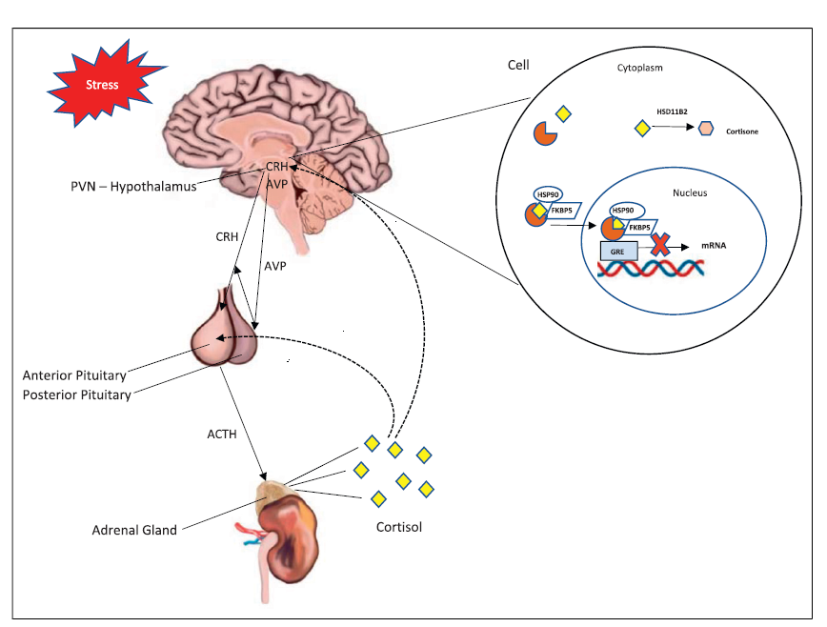
Framework
Nowak et al., 2022

Slide 52
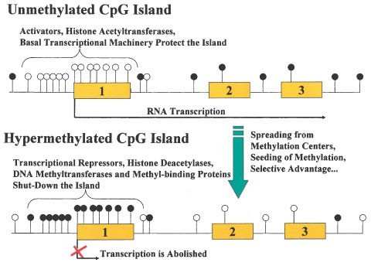
DNA Methylation – CpG Islands
C (cytosine) base followed immediately by a G (guanine) base (a CpG) is rare in vertebrate DNA because the cytosines in such an arrangement tend to be methylated
CpG islands typically occur at or near the transcription start site of genes, particularly housekeeping genes, in vertebrates.

Slide 53
Methods
Nowak et al., 2022
Examined DNA methylation of 6 candidate genes in glucocorticoid pathway
Study design: case-control study
Sample – self-identified Black or African American women ages 18-45 years of age, 8-18 weeks gestation
Detroit and Columbus
Cells from whole blood were used for DNA extraction

Slide 54
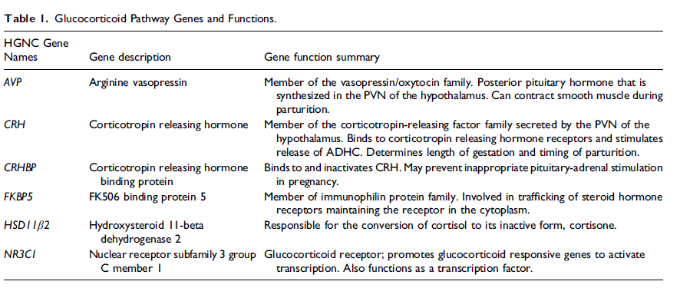
Methods – Target Genes

Slide 55
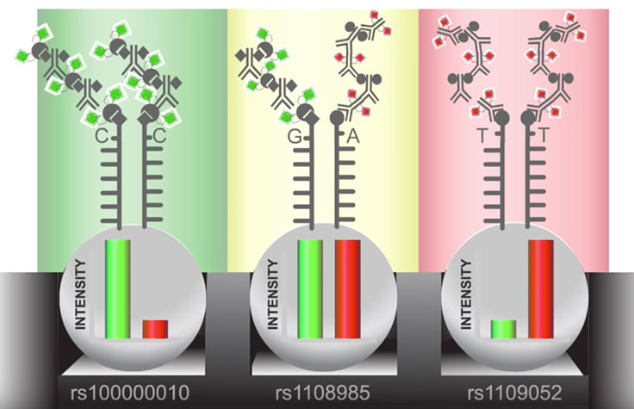
Methods – Variables and Measures
Nowak et al., 2022
DNA methylation
Bead array technology - uses silica microbeads coated with multiple copies of an oligonucleotide probe targeting a specific locus in the genome
DNA fragments pass over the bead and binds to a complementary sequence in the sample DNA
When excited by a laser, the nucleotide label emits a signal. The intensity of that signal conveys information about the allelic ratio at that locus.
Each assay genotypes a locus using two color readouts: one color for each allele. The relative intensity of the two colors indicate whether a genotype is heterozygous or homozygous at that locus.

Slide 56
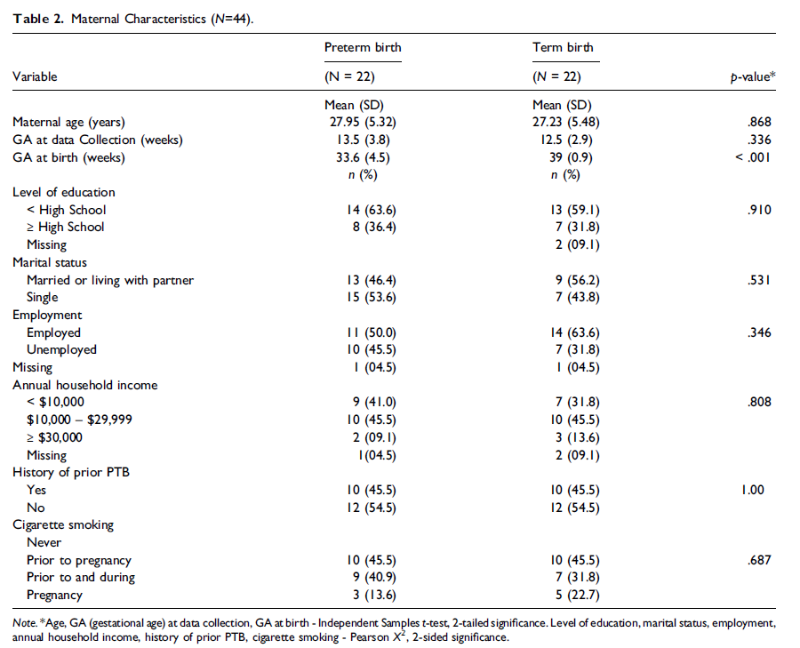
Results
Nowak et al., 2022

Slide 57
Results
Nowak et al., 2022
Four CpG sites in 2 genes were differentially methylated between women with preterm birth and term birth

Slide 58
Discussion – Strengths and Limitations
Nowak et al., 2022
This study was novel in identifying differences in DNA methylation of genes in the glucocorticoid pathway related to preterm birth
Recruited from 2 different geographic areas
Used fancy technology! That’s always fun.
No measures of gene expression were included
Measures of psychosocial stress were not included
Small sample size (N=44)

Slide 59
Accessing Genetic Applications in Your Research
Collaboration
Benefits
Barriers
Using outside labs
Benefits
Barriers

Slide 60
Discussion
More than 100,000 people die of adverse drug reactions each year. Another 2.2 million experience serious reactions. Others fail to respond at all to the therapeutic actions of drugs.
Explain how the use of information about single nucleotide polymorphisms might be used to map individual variations in drug responses.

Slide 61
Discussion
Sites in the DNA sequence where individuals differ at a single DNA base are called single nucleotide polymorphisms (SNPs).
Some of these SNPs may control a drug response phenotype.
As researchers map these SNPs to associate such genotype with drug response phenotype, it may be possible to identify persons who can be expected to respond favorably to a drug, those who can be expected to experience adverse reactions, and those that who not respond at all.

