Slide 1
Genetics 101: Gaining Understanding of Genomics in Research
Brittany Butts
August 16 – 17, 2022

Slide 2
Disclosures
Learner Outcome: After attending both half-day sessions, participants will have a general understanding of the role of genetics in human health and disease and research applications geared towards improving clinical practice.
Nursing Continuing Professional Development: 7.5 NCPD contact hours will be provided.
Participants must attend at least 90% of both half-day sessions and complete an evaluation survey to receive continuing nursing professional development contact hours.
UNC Charlotte School of Nursing is approved as a provider of nursing continuing professional development by the North Carolina Nurses Association, an accredited approver by the American Nurses Credentialing Center’s Commission on Accreditation.
The evaluation survey link will be sent to participants after the event is completed. The certificate will be attached to the end of the survey.

Slide 3
Part 1. Genetics and Epigenetics Primer
Genetic control of cell function
Chromosomes
Patterns of inheritance
Gene technology

Slide 4
Why do we want to study genetics?

Slide 5
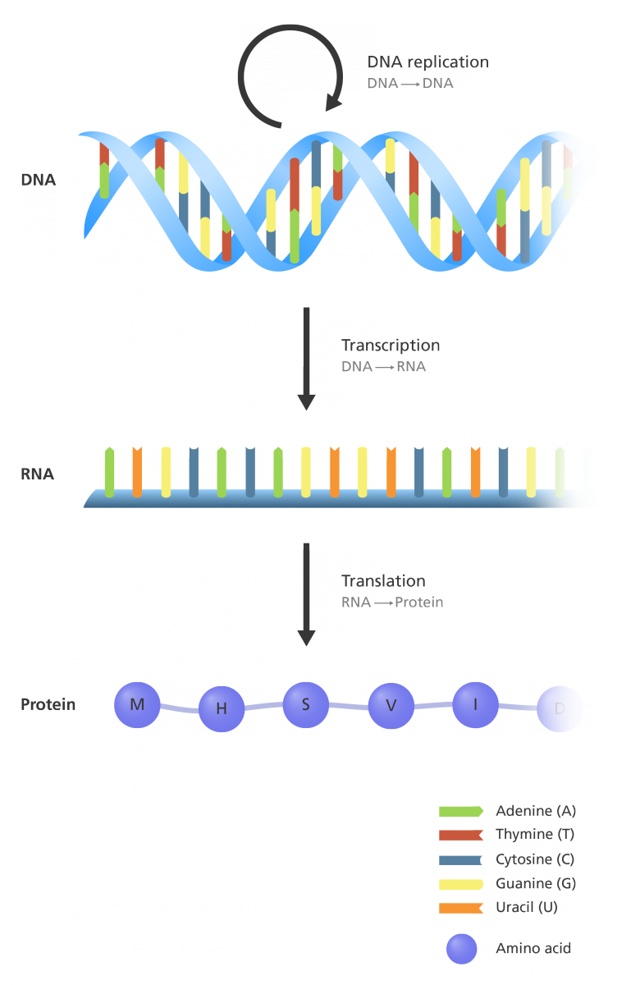
Central Dogma of Molecular Biology
How information in genes becomes proteins
Gene: sequence of DNA that encodes a functional product (generally a protein)
Genome: complete set of genes in an organism
Genetics – study of genes

Slide 6
Central Dogma of Molecular Biology
How information in genes becomes proteins
Transcription: DNA → RNA
Translation: RNA → protein
Transcriptome: complete set of mRNA transcripts

Slide 7
Central Dogma of Molecular Biology
How information in genes becomes proteins
Proteome – complete set of proteins encoded by a genome
Proteomics – study of the proteome

Slide 8
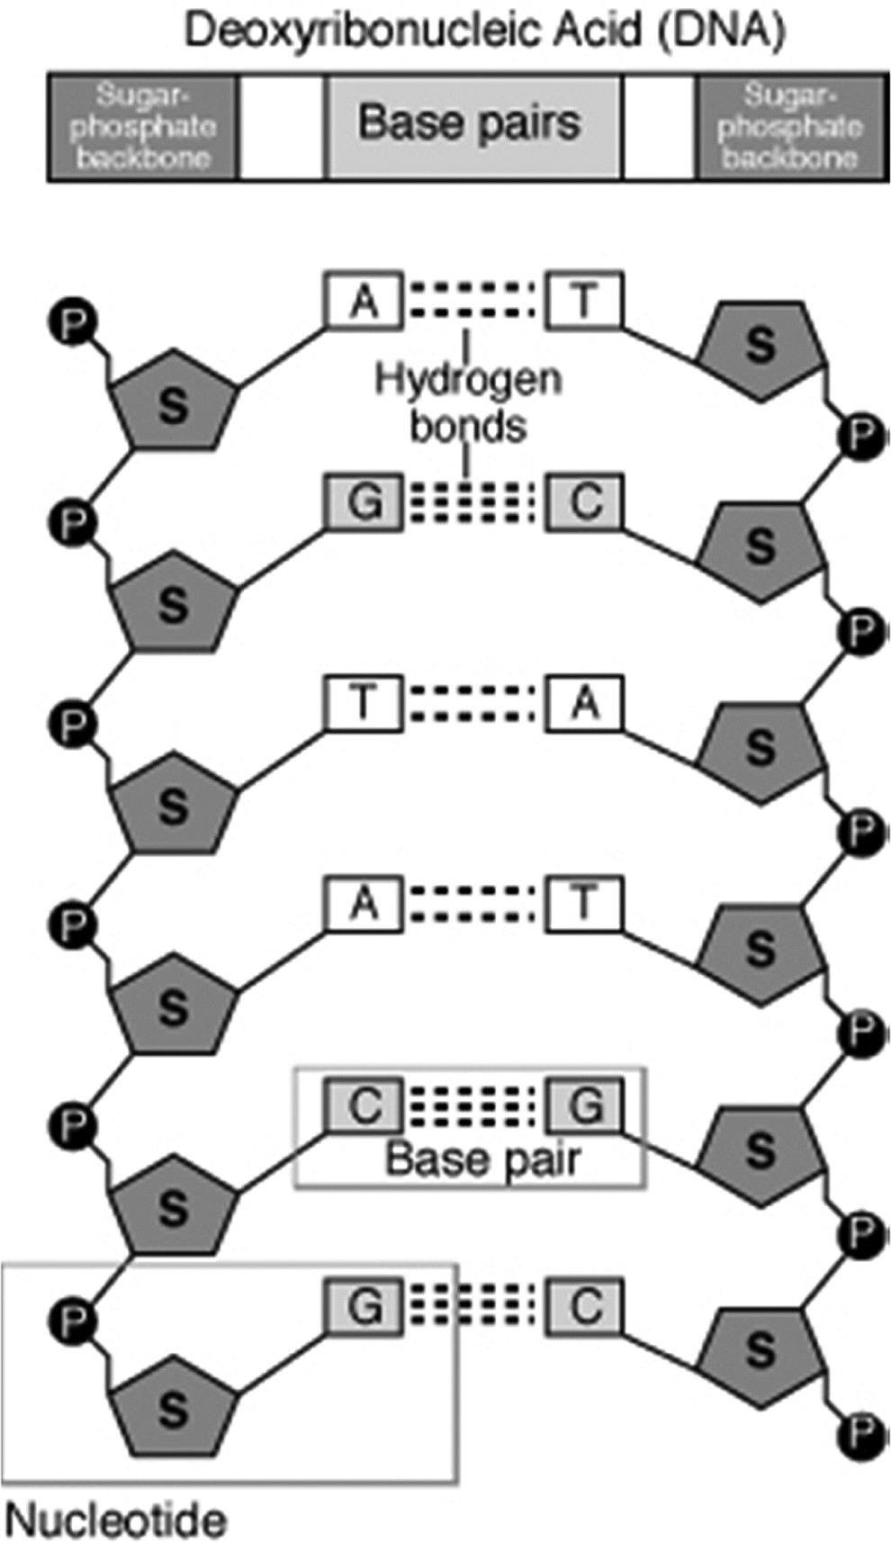
DNA Structure and Function
DNA stores our genetic information
Double-stranded helical structure
Backbone – alternating groups of sugar (deoxyribose) and phosphate
Nucleotides – nitrogenous bases that carry the genetic information
Dorman JS, et al. Biological Research For Nursing. 2017;19(1):7-17. doi:10.1177/1099800416678321

Slide 9
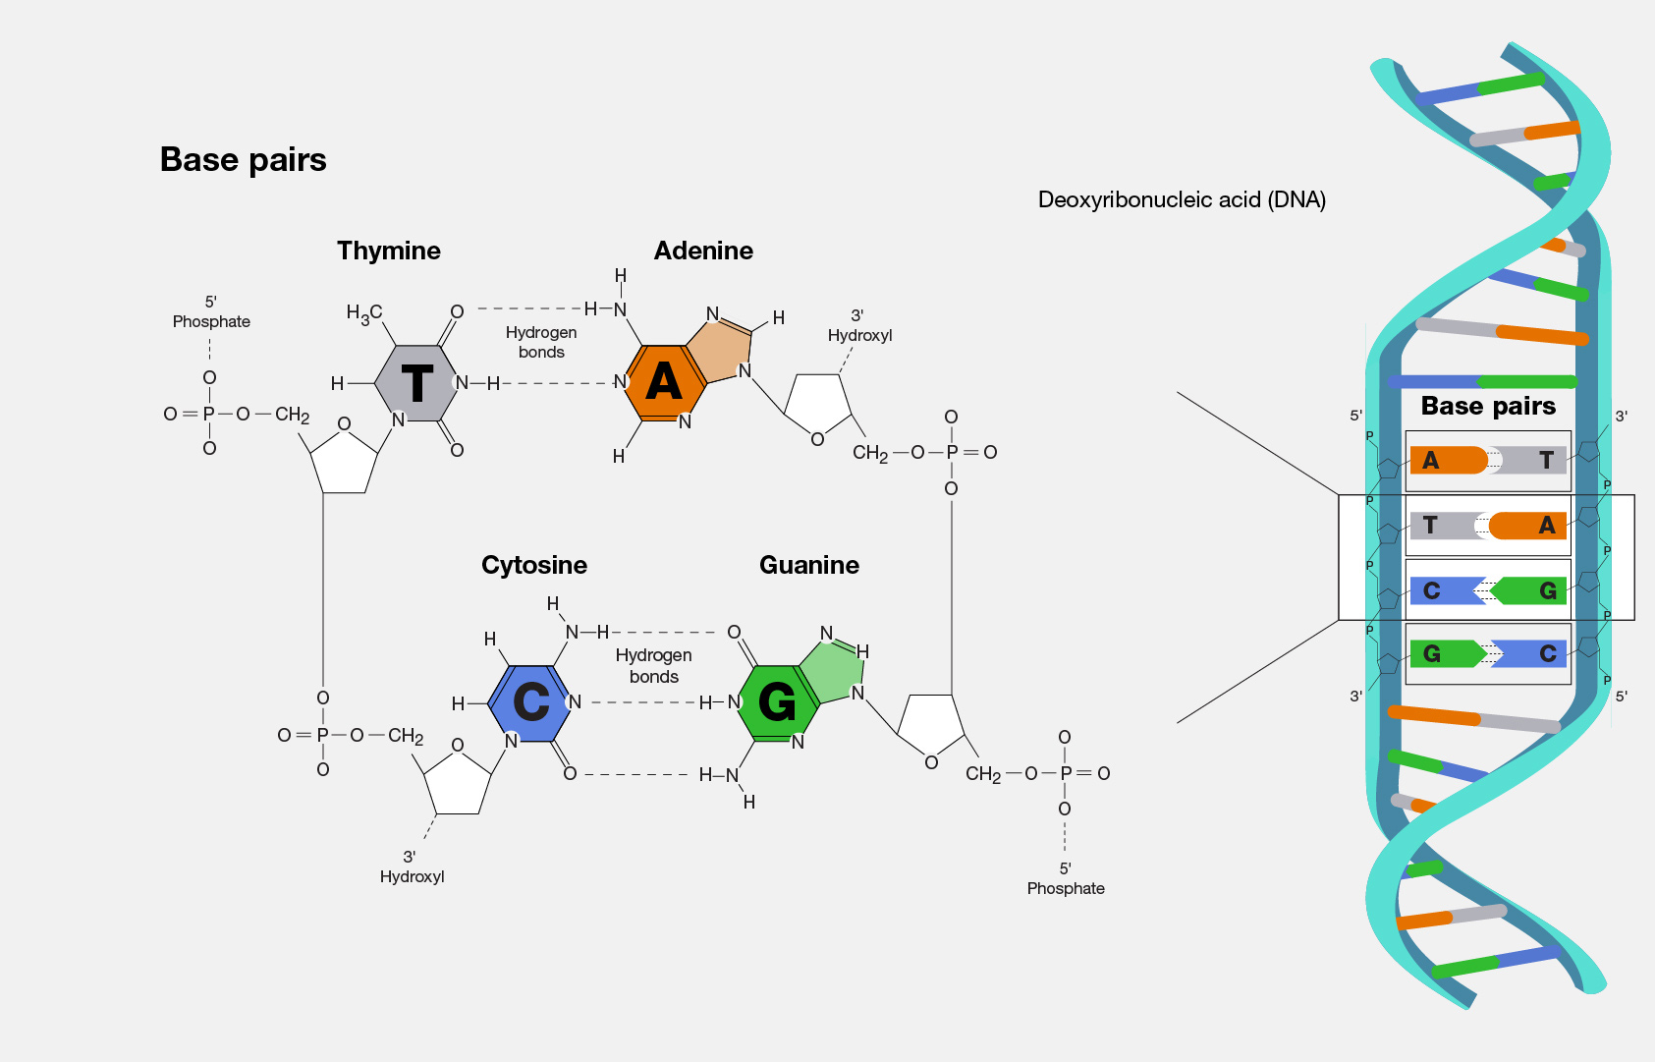
DNA Structure and Function
4 nucleotides
Adenine
Thymine
Cytosine
Guanine
Base pairs
A-T
C-G
https://www.genome.gov/genetics-glossary/Base-Pair

Slide 10
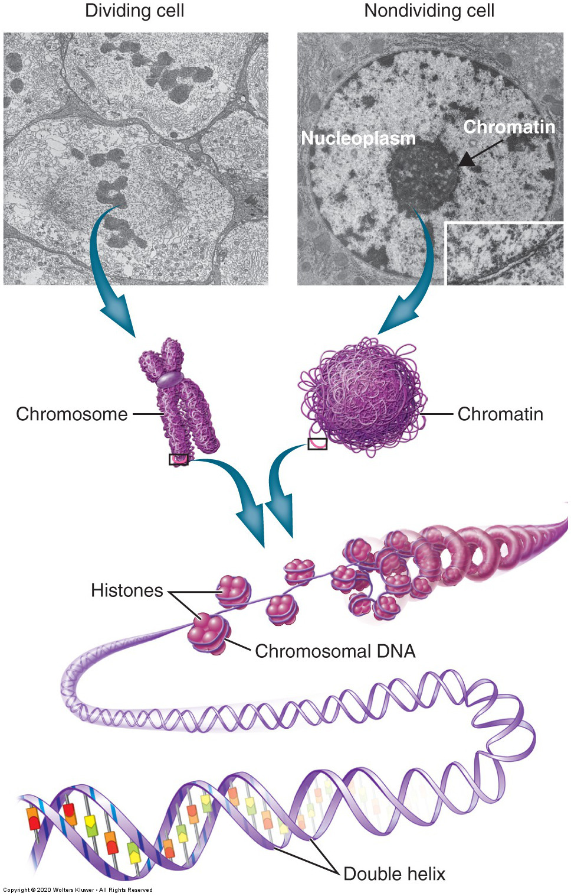
Packaging of DNA
Genome is divided into chromosomes – discrete bundles of a continuous, linear DNA helix.
Humans have 23 pairs of chromosomes
22 pairs of autosomes
1 pair of sex chromosomes
Chromatin – tightly coiled complex of DNA
Fun Facts
If you stretched out DNA:
The longest strand would be over 7 cm
All chromosomes end to end would be over 6 feet!

Slide 11
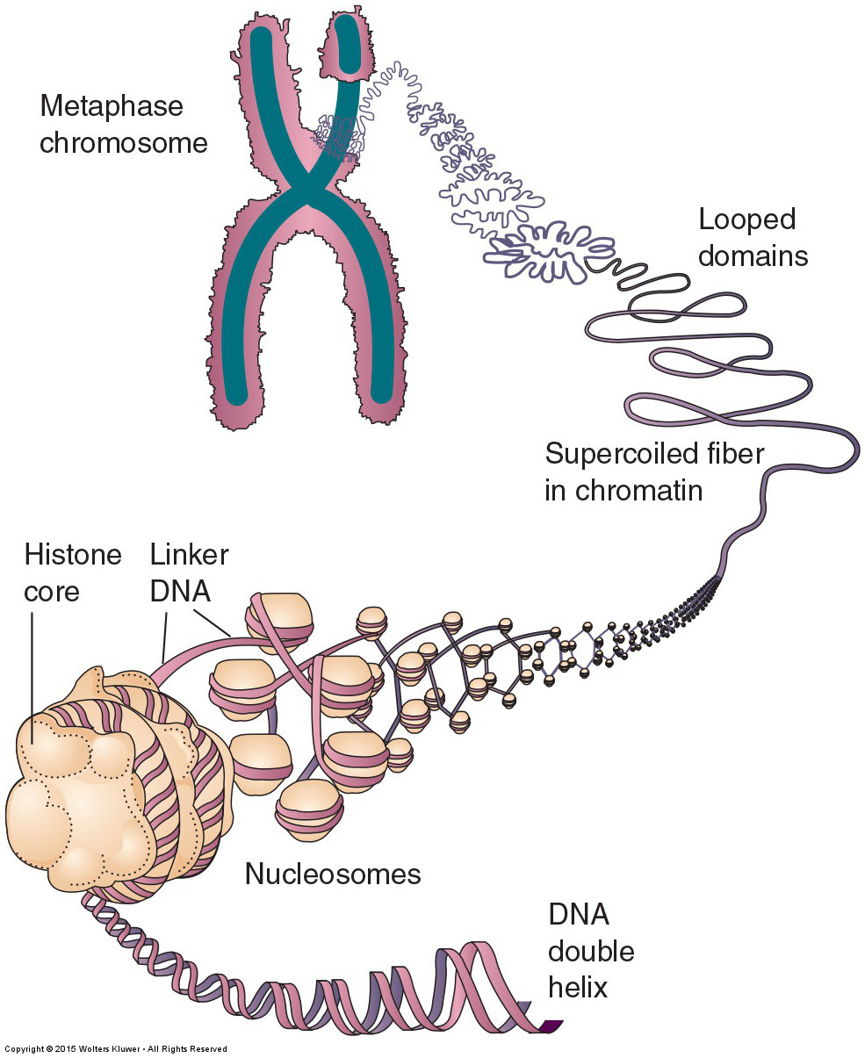
Packaging of DNA
Histone – proteins that package DNA
Molecules on histones control access to DNA for gene expression (histone modifications)
Histone acetylation – turns genes on by opening chromatin fiber to allow transcription
CH₃CO
Histone methylation – turns genes off
CH₃

Slide 12
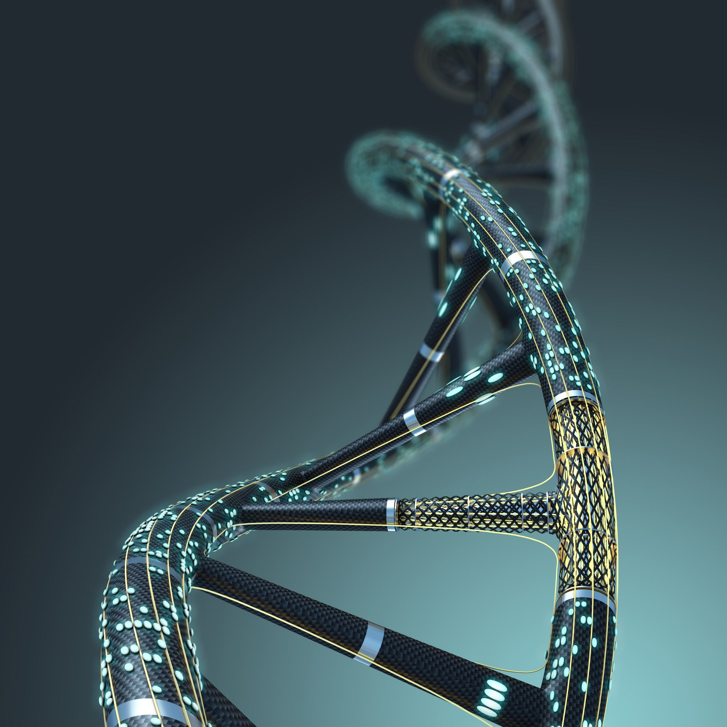
DNA Repair
What are some things that can damage our DNA?

Slide 13
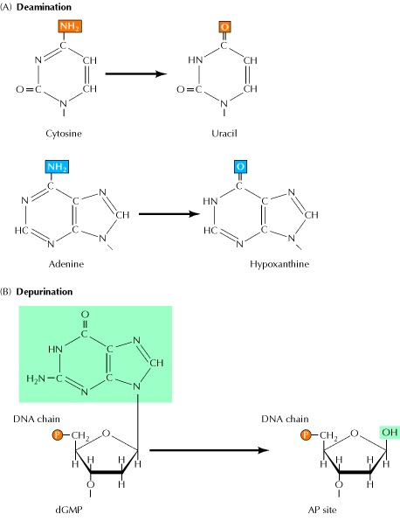
DNA Repair
What are some things that
damage our DNA?
Mutations occur due to:
Spontaneous mutation

Slide 14
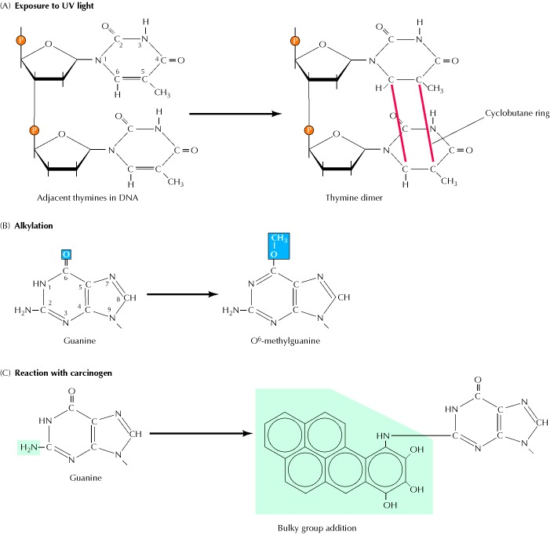
DNA Repair
What are some things that
damage our DNA?
Mutations occur due to:
Spontaneous mutation
Environmental agents
Chemicals
Radiation

Slide 15
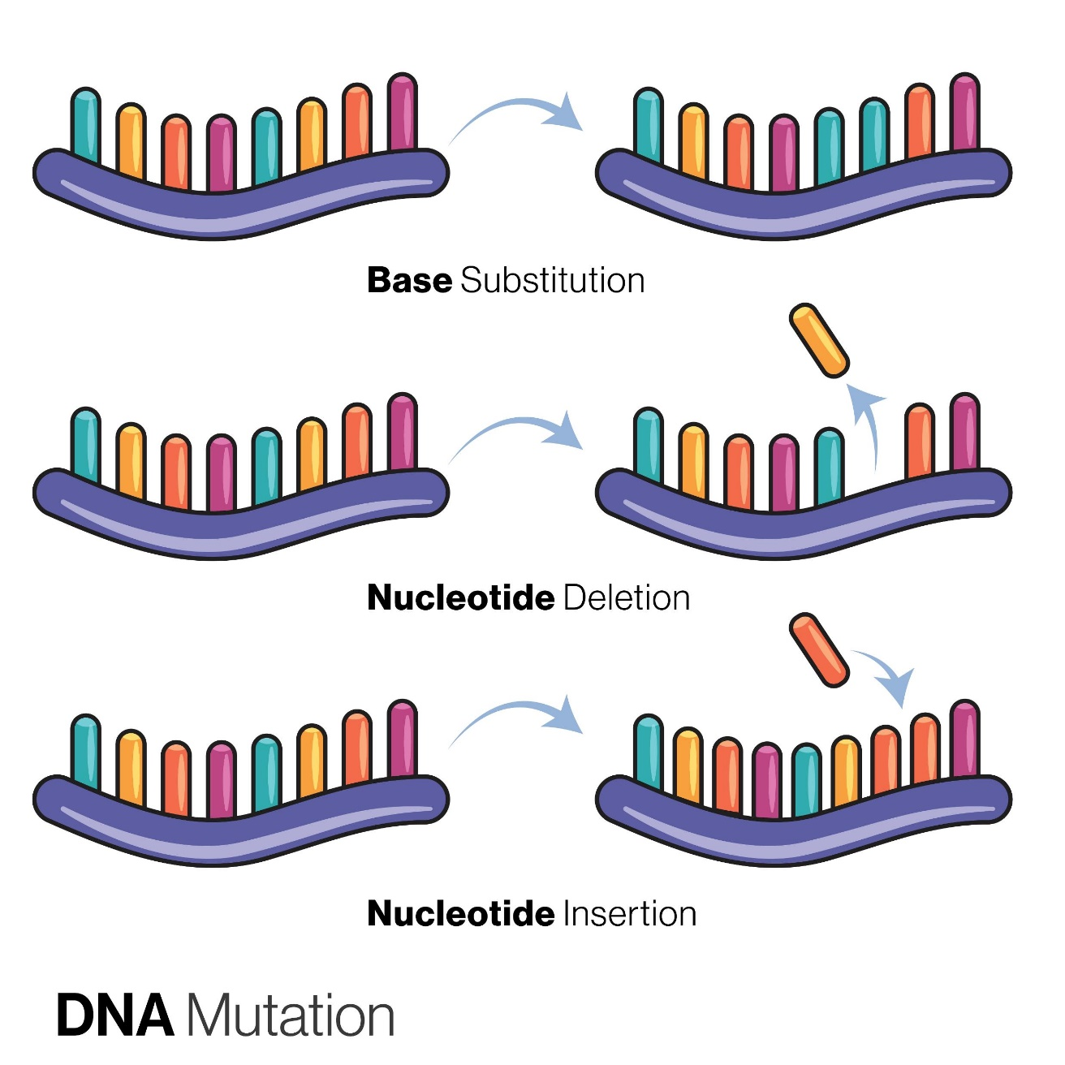
DNA Repair
Mutations can include:
Change of one base pair to another
Loss or addition of base pair(s)
Rearrangement of base pair

Slide 16
Notes:
Poll Title: Do not modify the notes in this section to avoid tampering with the Poll Everywhere activity. More info at polleverywhere.com/support How could a health care professional most accurately explain an aspect of the underlying structure of DNA to a colleague who is unfamiliar with genetics? https://www.polleverywhere.com/multiple_choice_polls/lRmPYmT09KC28rt9RU58Z?display_state=instructions&activity_state=opened&state=opened&flow=Instructor&onscreen=persist

Slide 17
Notes:
Poll Title: Do not modify the notes in this section to avoid tampering with the Poll Everywhere activity. More info at polleverywhere.com/support How could a health care professional most accurately explain an aspect of the underlying structure of DNA to a colleague who is unfamiliar with genetics? https://www.polleverywhere.com/multiple_choice_polls/lRmPYmT09KC28rt9RU58Z?display_state=chart&activity_state=closed&state=closed&flow=Instructor&onscreen=persist

Slide 18
Notes:
Poll Title: Do not modify the notes in this section to avoid tampering with the Poll Everywhere activity. More info at polleverywhere.com/support How could a health care professional most accurately explain an aspect of the underlying structure of DNA to a colleague who is unfamiliar with genetics? https://www.polleverywhere.com/multiple_choice_polls/lRmPYmT09KC28rt9RU58Z?display_state=chart&activity_state=closed&display=correctness&state=closed&flow=Instructor&onscreen=persist

Slide 19
Notes:
Poll Title: Do not modify the notes in this section to avoid tampering with the Poll Everywhere activity. More info at polleverywhere.com/support When an infant is born with gene mutations in his cells, the nurse explains to the parents that accidental errors may be a result of: Select all that apply. https://www.polleverywhere.com/multiple_choice_polls/8IxEXhgSPPs0LlplRsneN?display_state=instructions&activity_state=opened&state=opened&flow=Instructor&onscreen=persist

Slide 20
Notes:
Poll Title: Do not modify the notes in this section to avoid tampering with the Poll Everywhere activity. More info at polleverywhere.com/support When an infant is born with gene mutations in his cells, the nurse explains to the parents that accidental errors may be a result of: Select all that apply. https://www.polleverywhere.com/multiple_choice_polls/8IxEXhgSPPs0LlplRsneN?display_state=chart&activity_state=closed&state=closed&flow=Instructor&onscreen=persist

Slide 21
Notes:
Poll Title: Do not modify the notes in this section to avoid tampering with the Poll Everywhere activity. More info at polleverywhere.com/support When an infant is born with gene mutations in his cells, the nurse explains to the parents that accidental errors may be a result of: Select all that apply. https://www.polleverywhere.com/multiple_choice_polls/8IxEXhgSPPs0LlplRsneN?display_state=chart&activity_state=closed&display=correctness&state=closed&flow=Instructor&onscreen=persist

Slide 22
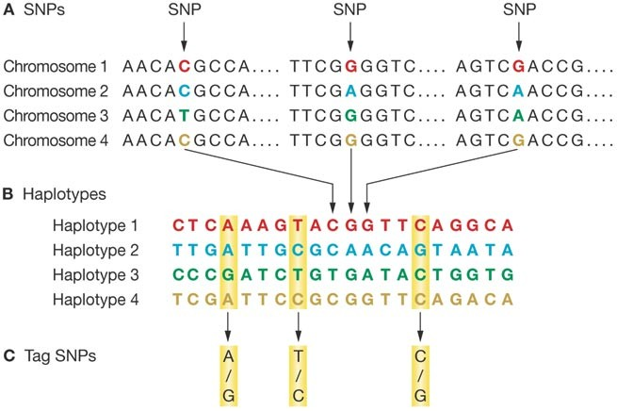
Genetic Variability
We share 99.9% of our genome sequence
The 0.01% is what counts for individual variation across the population
https://www.genome.gov/genetics-glossary
Skelding, K., Gerhard, G., Simari, R. et al. The effect of HapMap on cardiovascular research and clinical practice. Nat Rev Cardiol 4, 136–142 (2007). https://doi.org/10.1038/ncpcardio0830

Slide 23
Genetic Variability
Polymorphisms - the presence of two or more variant forms of a specific DNA sequence that can occur among different individuals or populations
Single nucleotide polymorphisms (SNPs) are most common type

Slide 24
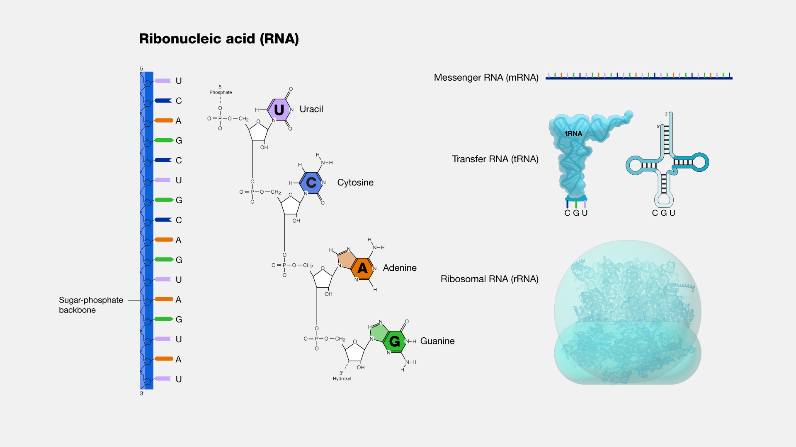
Ribonucleic Acid (RNA) Structure and Function
Structure
Single-stranded
Sugar is ribose
Uracil not Thymine
Functions
Messenger RNA
Transfer RNA
Ribosomal RNA

Slide 25
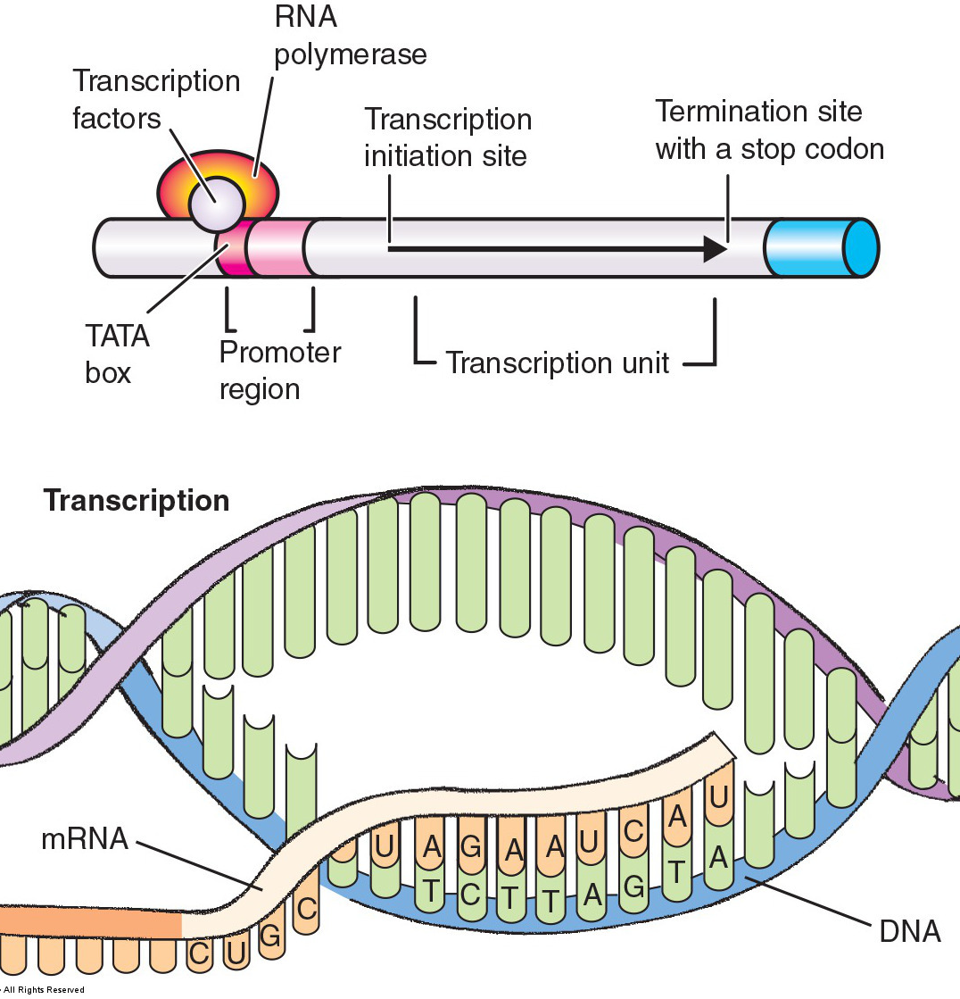
From Genes to Proteins
DNA stores the code, but RNA does the heavy lifting in the process of gene expression
Transcription
Occurs in nucleus
Uses DNA as template to make mRNA
Genes transcribed by RNA polymerase
Binds to promoter region
mRNA is the template for translation
But first it must be processed

Slide 26
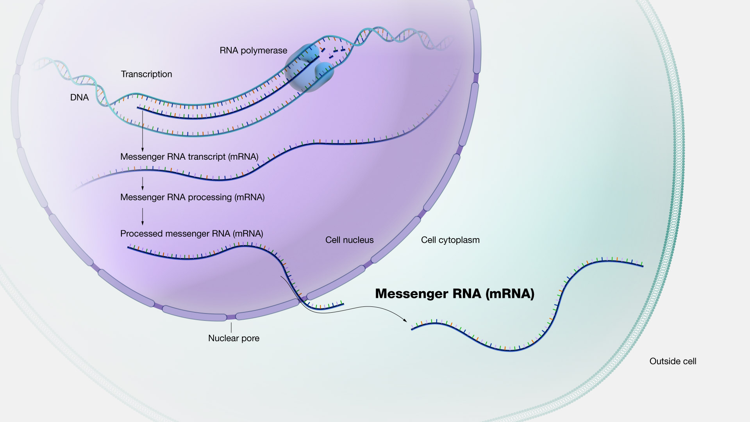
mRNA

Slide 28
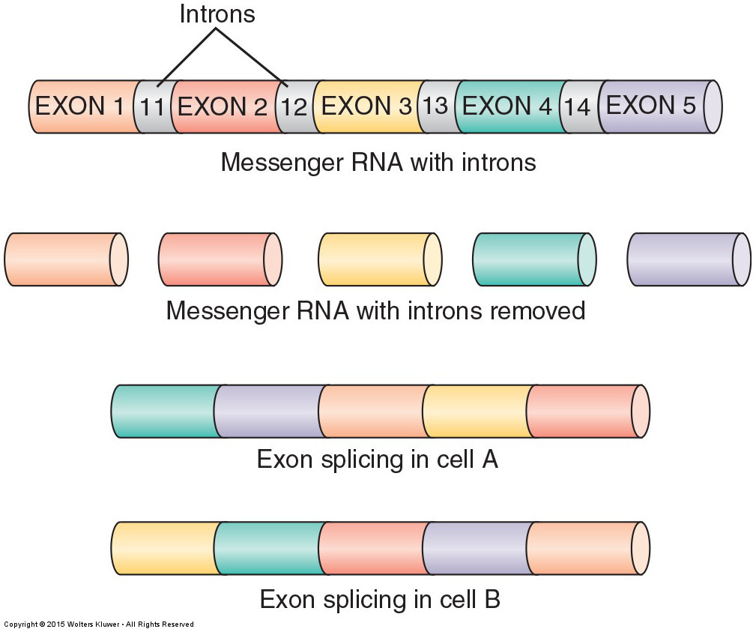
Messenger RNA processing
DNA contains exons and introns
Exon – protein coding region
Intron – non-coding region
Splicing – editing regions of mRNA
Kind of like film splicing
Removes introns and varies segments
Allows for a variety of protein products

Slide 29
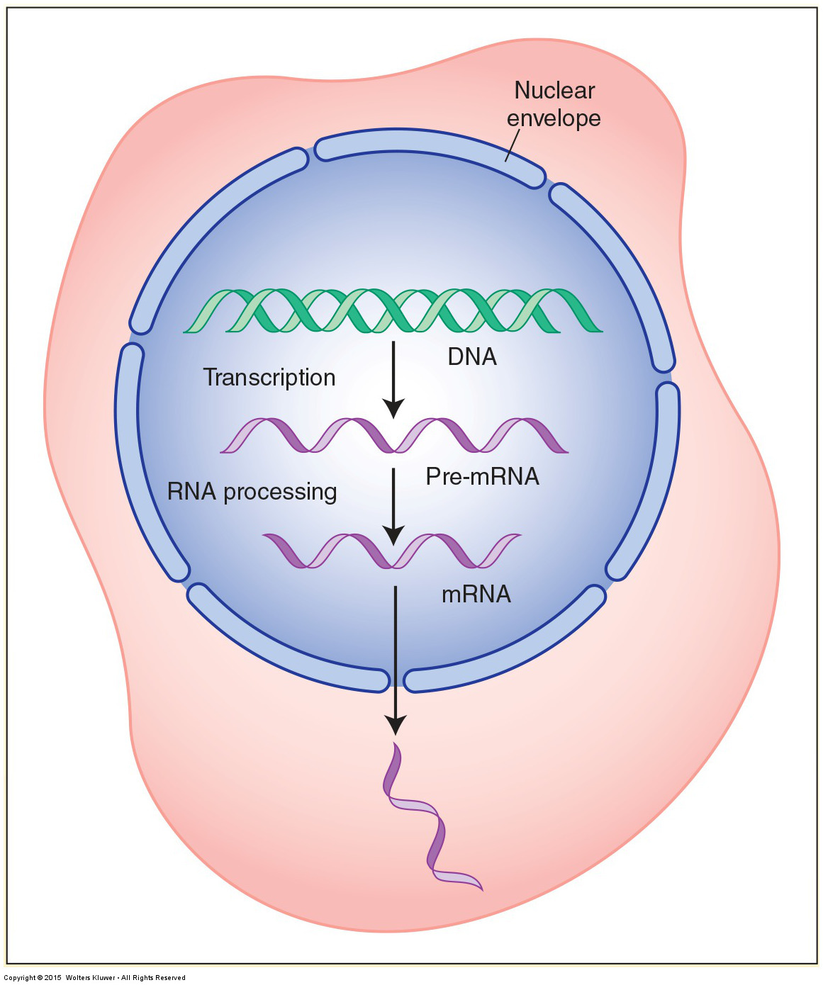
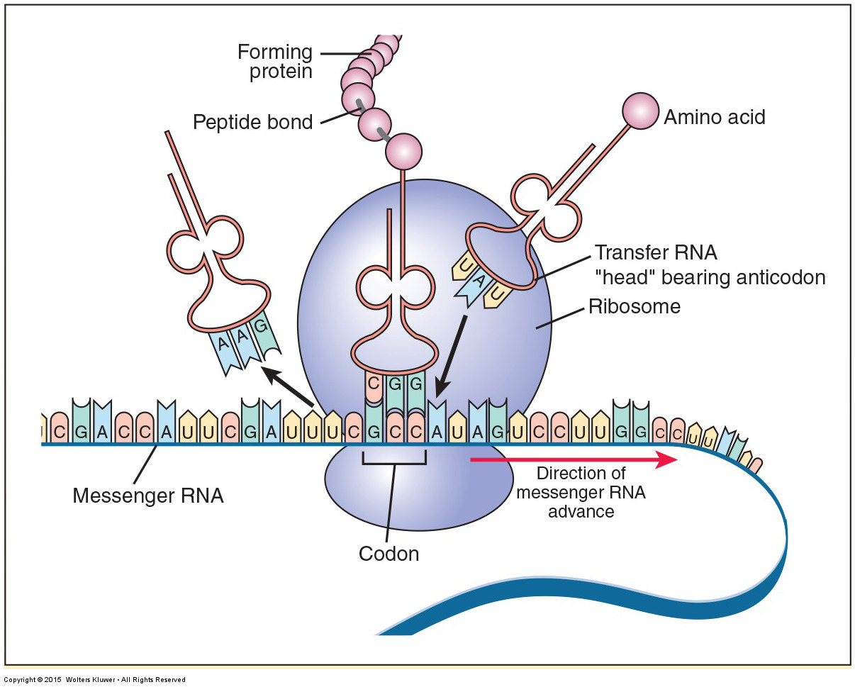
Transcription → Translation
Each codon/anticodon represents an amino acid

Slide 30
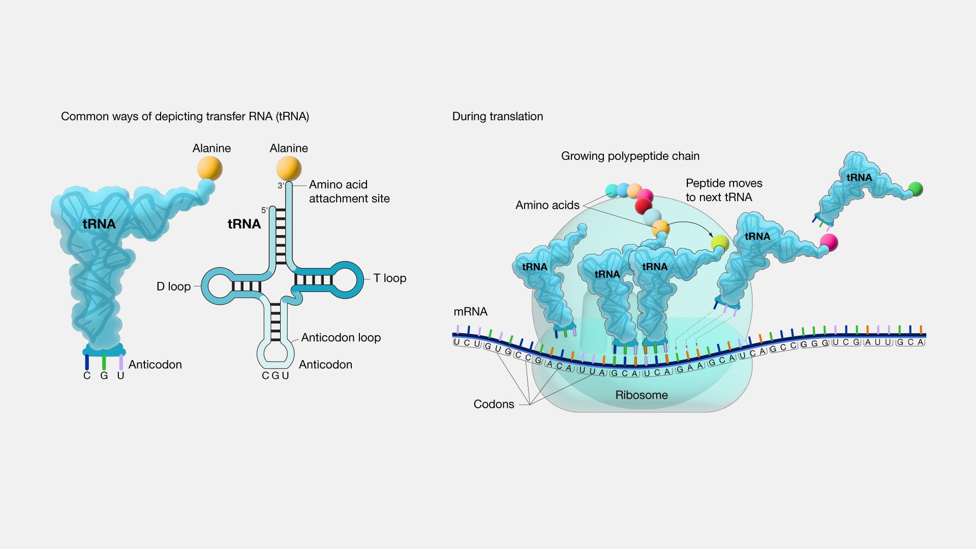

Slide 31
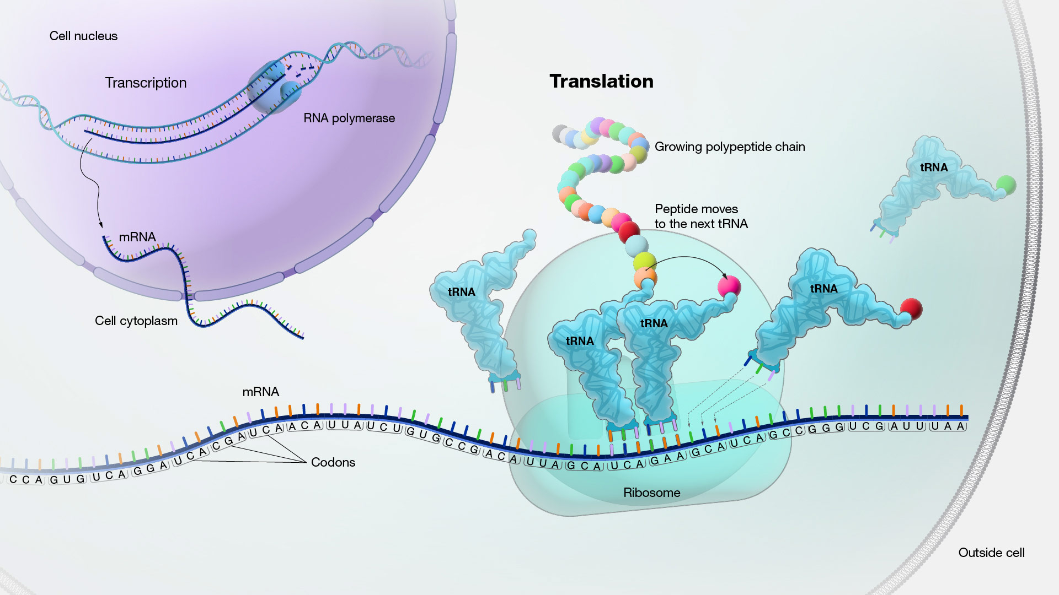

Slide 33
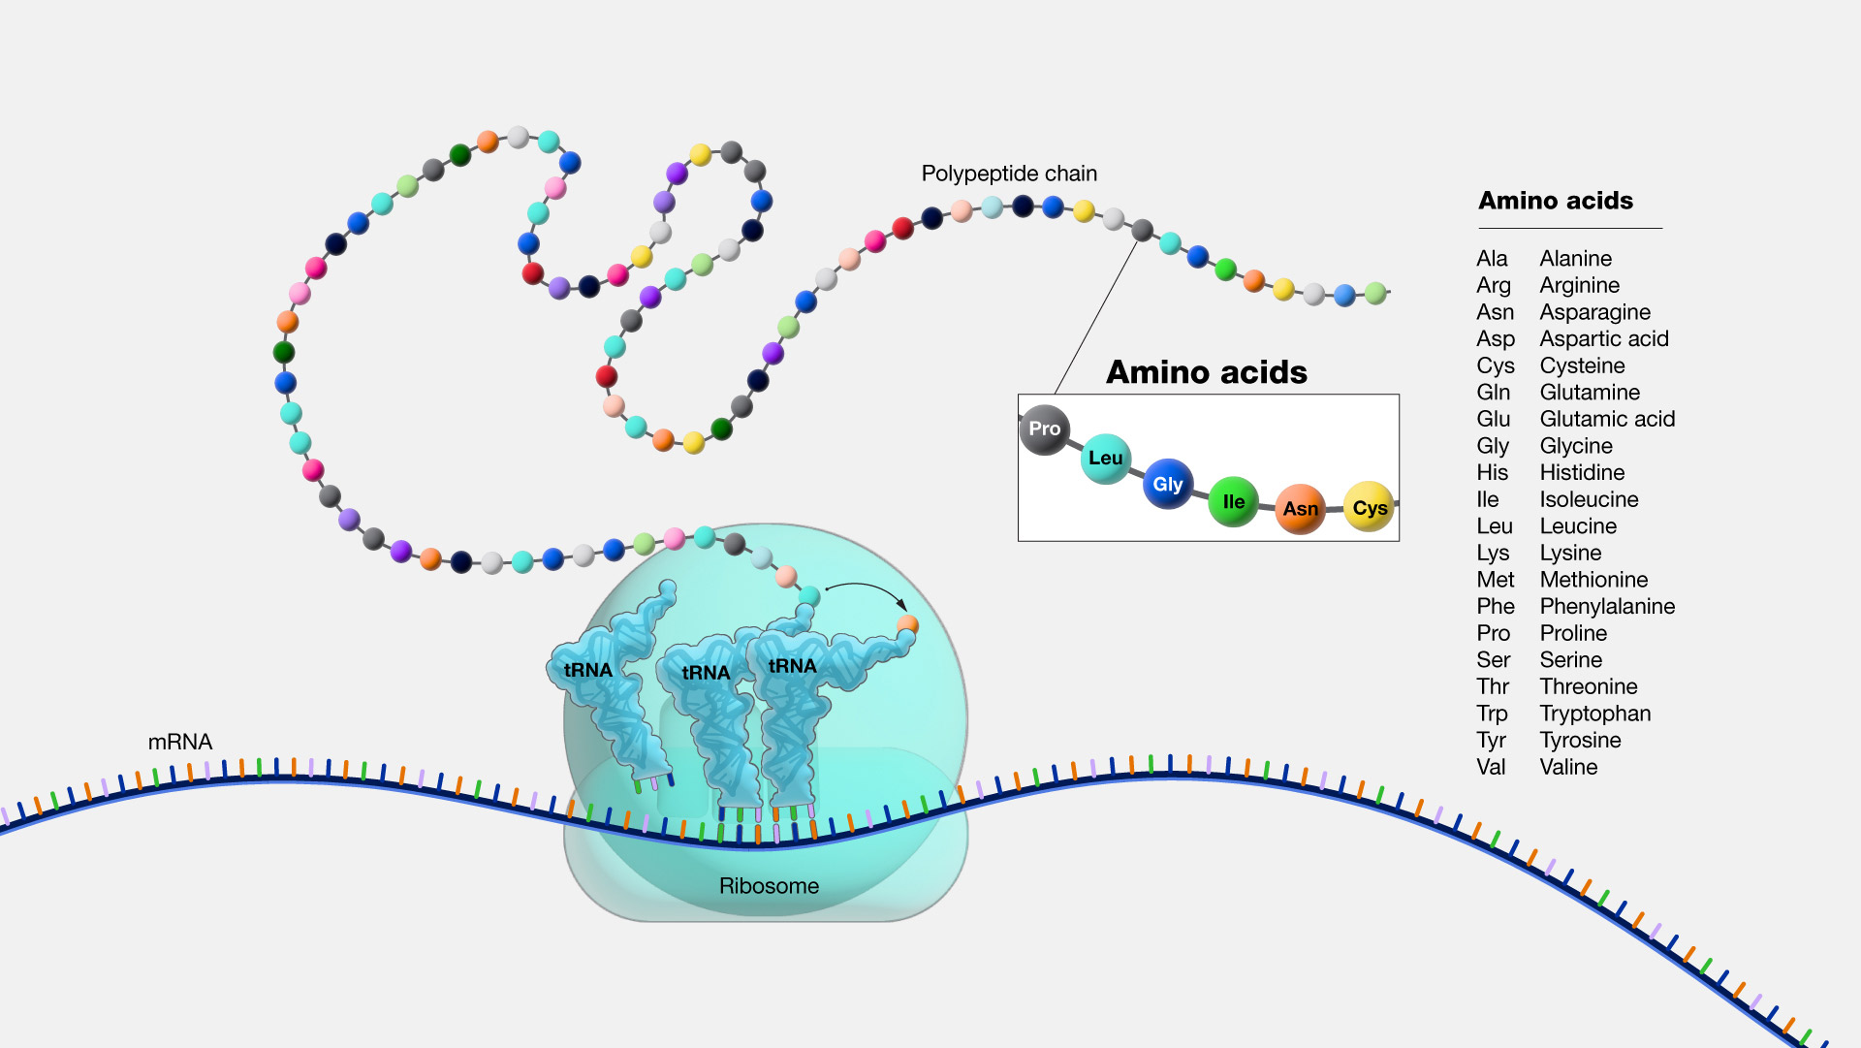
Amino Acids → Proteins
Fundamental molecule that serves as the building block for proteins.
20 different amino acids.
A protein consists of one or more chains of amino acids (polypeptides) whose sequence is encoded in a gene.
Some amino acids can be synthesized in the body
Essential amino acids must be obtained from a person’s diet.

Slide 34
Notes:
Poll Title: Do not modify the notes in this section to avoid tampering with the Poll Everywhere activity. More info at polleverywhere.com/support In the context of an explanation of how human growth occurs, a student is explaining to a colleague the necessity and roles of different types of RNA in protein synthesis. Which type of RNA is a result of the process of transcription? https://www.polleverywhere.com/multiple_choice_polls/DoMZ9ZDdw5p5VIKXcZRnI?display_state=instructions&activity_state=opened&state=opened&flow=Instructor&onscreen=persist

Slide 35
Notes:
Poll Title: Do not modify the notes in this section to avoid tampering with the Poll Everywhere activity. More info at polleverywhere.com/support In the context of an explanation of how human growth occurs, a student is explaining to a colleague the necessity and roles of different types of RNA in protein synthesis. Which type of RNA is a result of the process of transcription? https://www.polleverywhere.com/multiple_choice_polls/DoMZ9ZDdw5p5VIKXcZRnI?display_state=chart&activity_state=closed&state=closed&flow=Instructor&onscreen=persist

Slide 36
Notes:
Poll Title: Do not modify the notes in this section to avoid tampering with the Poll Everywhere activity. More info at polleverywhere.com/support In the context of an explanation of how human growth occurs, a student is explaining to a colleague the necessity and roles of different types of RNA in protein synthesis. Which type of RNA is a result of the process of transcription? https://www.polleverywhere.com/multiple_choice_polls/DoMZ9ZDdw5p5VIKXcZRnI?display_state=chart&activity_state=closed&display=correctness&state=closed&flow=Instructor&onscreen=persist

Slide 37
Notes:
Poll Title: Do not modify the notes in this section to avoid tampering with the Poll Everywhere activity. More info at polleverywhere.com/support While explaining the individual differences in physical traits in the family group, the health care provider states this is usually a result of: https://www.polleverywhere.com/multiple_choice_polls/2jfz7MC7wJed524GJhiFc?display_state=instructions&activity_state=opened&state=opened&flow=Instructor&onscreen=persist

Slide 38
Notes:
Poll Title: Do not modify the notes in this section to avoid tampering with the Poll Everywhere activity. More info at polleverywhere.com/support While explaining the individual differences in physical traits in the family group, the health care provider states this is usually a result of: https://www.polleverywhere.com/multiple_choice_polls/2jfz7MC7wJed524GJhiFc?display_state=chart&activity_state=closed&state=closed&flow=Instructor&onscreen=persist

Slide 39
Notes:
Poll Title: Do not modify the notes in this section to avoid tampering with the Poll Everywhere activity. More info at polleverywhere.com/support While explaining the individual differences in physical traits in the family group, the health care provider states this is usually a result of: https://www.polleverywhere.com/multiple_choice_polls/2jfz7MC7wJed524GJhiFc?display_state=chart&activity_state=closed&display=correctness&state=closed&flow=Instructor&onscreen=persist

Slide 40
Notes:
Poll Title: Do not modify the notes in this section to avoid tampering with the Poll Everywhere activity. More info at polleverywhere.com/support Which of the following statements is true of messenger RNA (mRNA)? https://www.polleverywhere.com/multiple_choice_polls/JSeSp1FF7Lj4dMTXmoHyP?display_state=instructions&activity_state=opened&state=opened&flow=Instructor&onscreen=persist

Slide 41
Notes:
Poll Title: Do not modify the notes in this section to avoid tampering with the Poll Everywhere activity. More info at polleverywhere.com/support Which of the following statements is true of messenger RNA (mRNA)? https://www.polleverywhere.com/multiple_choice_polls/JSeSp1FF7Lj4dMTXmoHyP?display_state=chart&activity_state=closed&state=closed&flow=Instructor&onscreen=persist

Slide 42
Notes:
Poll Title: Do not modify the notes in this section to avoid tampering with the Poll Everywhere activity. More info at polleverywhere.com/support Which of the following statements is true of messenger RNA (mRNA)? https://www.polleverywhere.com/multiple_choice_polls/JSeSp1FF7Lj4dMTXmoHyP?display_state=chart&activity_state=closed&display=correctness&state=closed&flow=Instructor&onscreen=persist

Slide 43
Notes:
Poll Title: Do not modify the notes in this section to avoid tampering with the Poll Everywhere activity. More info at polleverywhere.com/support Splicing of mRNA during processing permits a cell to: https://www.polleverywhere.com/multiple_choice_polls/kNLCWxVbZCHHQvKiXt7eZ?display_state=instructions&activity_state=opened&state=opened&flow=Instructor&onscreen=persist

Slide 44
Notes:
Poll Title: Do not modify the notes in this section to avoid tampering with the Poll Everywhere activity. More info at polleverywhere.com/support Splicing of mRNA during processing permits a cell to: https://www.polleverywhere.com/multiple_choice_polls/kNLCWxVbZCHHQvKiXt7eZ?display_state=chart&activity_state=closed&state=closed&flow=Instructor&onscreen=persist

Slide 45
Notes:
Poll Title: Do not modify the notes in this section to avoid tampering with the Poll Everywhere activity. More info at polleverywhere.com/support Splicing of mRNA during processing permits a cell to: https://www.polleverywhere.com/multiple_choice_polls/kNLCWxVbZCHHQvKiXt7eZ?display_state=chart&activity_state=closed&display=correctness&state=closed&flow=Instructor&onscreen=persist

Slide 46
Regulation of Gene Expression
About 2% of our genome encode instructions for protein synthesis (genes)
The rest is made up of non-coding regions
Structural
Regulate gene expression

Slide 47
How do our cells have the same DNA but have different structures and functions?

Slide 48
Gene Expression—Is the Protein Produced?
The degree to which a gene or particular group of genes are actually being transcribed
Genes “turn on” and “turn off”
Induction: something turns a gene on
Repression: something turns a gene off
Transcription factors – proteins that initiate and regulate transcription

Slide 49
Gene Expression—Is the Protein Produced?
The degree to which a gene or particular group of genes are actually being transcribed
Genes “turn on” and “turn off”
Induction: something turns a gene on
Repression: something turns a gene off
Transcription factors – proteins that initiate and regulate transcription

Slide 50
Gene Expression—Is the Protein Produced?
The degree to which a gene or particular group of genes are actually being transcribed
Genes “turn on” and “turn off”
Induction: something turns a gene on
Repression: something turns a gene off
Transcription factors – proteins that initiate and regulate transcription

Slide 51
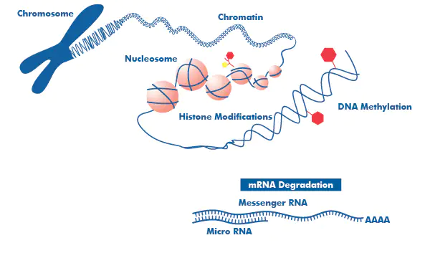
Epigenetics
Changes in gene expression caused by mechanisms OTHER THAN changes in DNA sequence

Slide 52
Epigenetics
Changes in gene expression caused by mechanisms OTHER THAN changes in DNA sequence
Maintained in successive mitotic cell divisions

Slide 53
Epigenetics
Changes in gene expression caused by mechanisms OTHER THAN changes in DNA sequence
Maintained in successive mitotic cell divisions
Can be modified through environmental factors (diet, chemical exposure)

Slide 54
Epigenetic Modifications
Epigenetic modifications control access to DNA and sites of transcription

Slide 55
Epigenetic Modifications
DNA methylation
Histone modifications
RNA-based mechanisms

Slide 56
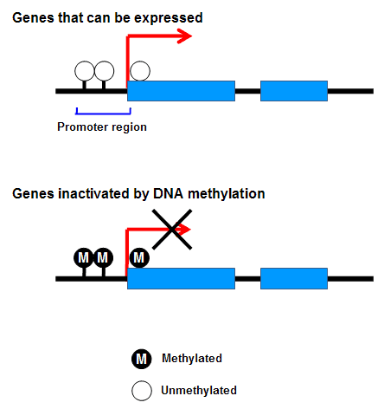
DNA Methylation
Addition of a methyl group to DNA.
Methylation usually in specific places on the DNA, where it blocks the proteins that attach to DNA to “read” the gene.
Reversed through demethylation.
Typically, methylation turns genes “off” and demethylation turns genes “on.”

Slide 57
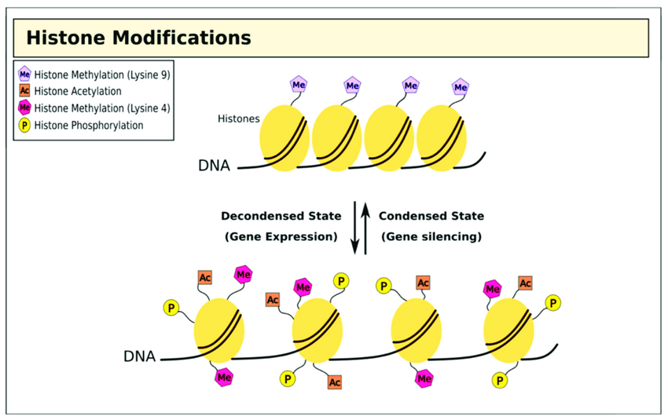
Histone Modifications
DNA wrapped tightly around histones cannot be accessed
Chemical groups can be added or removed from histones and change whether a gene is unwrapped or wrapped
ON or OFF

Slide 58
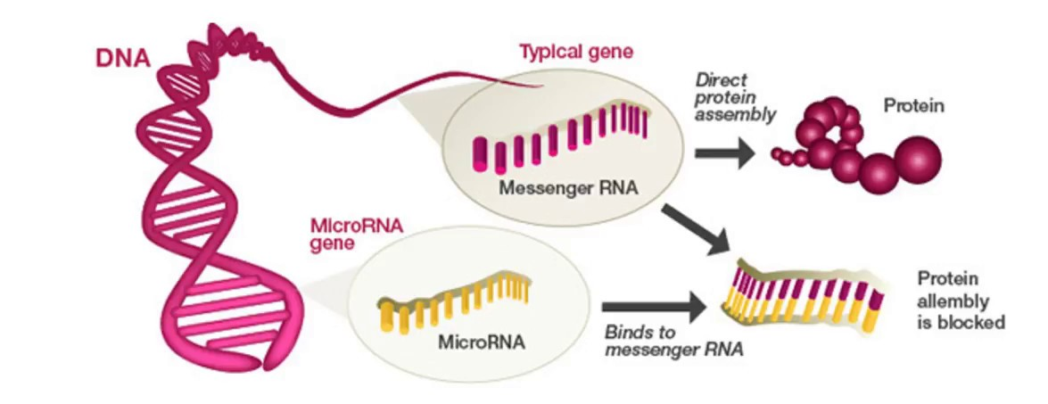
Non-coding RNA
Coding RNA is used to make proteins.
Non-coding RNA helps control gene expression
Helps to break down coding RNA
Recruit proteins to modify histones to turn genes on or off

Slide 59
Discussion Question:
The Human Genome Project found that humans have only around 30,000 genes. Only about 2% of the genome encodes instructions for protein synthesis, while 50% consists of repeat sequences that do not encode proteins.
Use this information to explain how this small number of protein-encoding genes is able to produce the vast array of proteins needed for organ and structural development in the embryo as well as those needed for normal function of the body across the lifespan.

Slide 60
Discussion Suggested Answers
1. Control of gene expression – during embryonic development, different genes are expressed or repressed at different times in order to control organ and structural development. Similarly, different genes are expressed or repressed in different tissues and at different times to allow normal function of the body in postnatal life. Not all genes will be expressed at all times.
2. mRNA splicing – alternate splicing of mRNA allows the same DNA template to be used to make more than one protein, and so one gene can be used to create many different proteins.
3. Post-translational modifications – other times, proteins may be modified after translation (i.e., by combining with other polypeptide chains, binding co-factors, or undergoing enzymatic modification), which will create a new and alternative protein product.

Slide 61
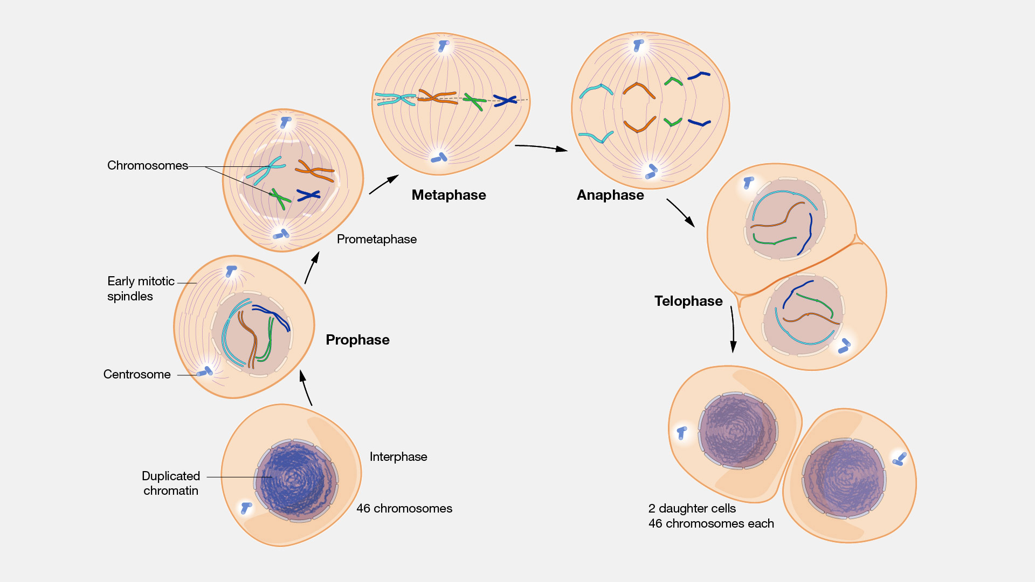
Mitosis – Duplication of Somatic Cells

Slide 63
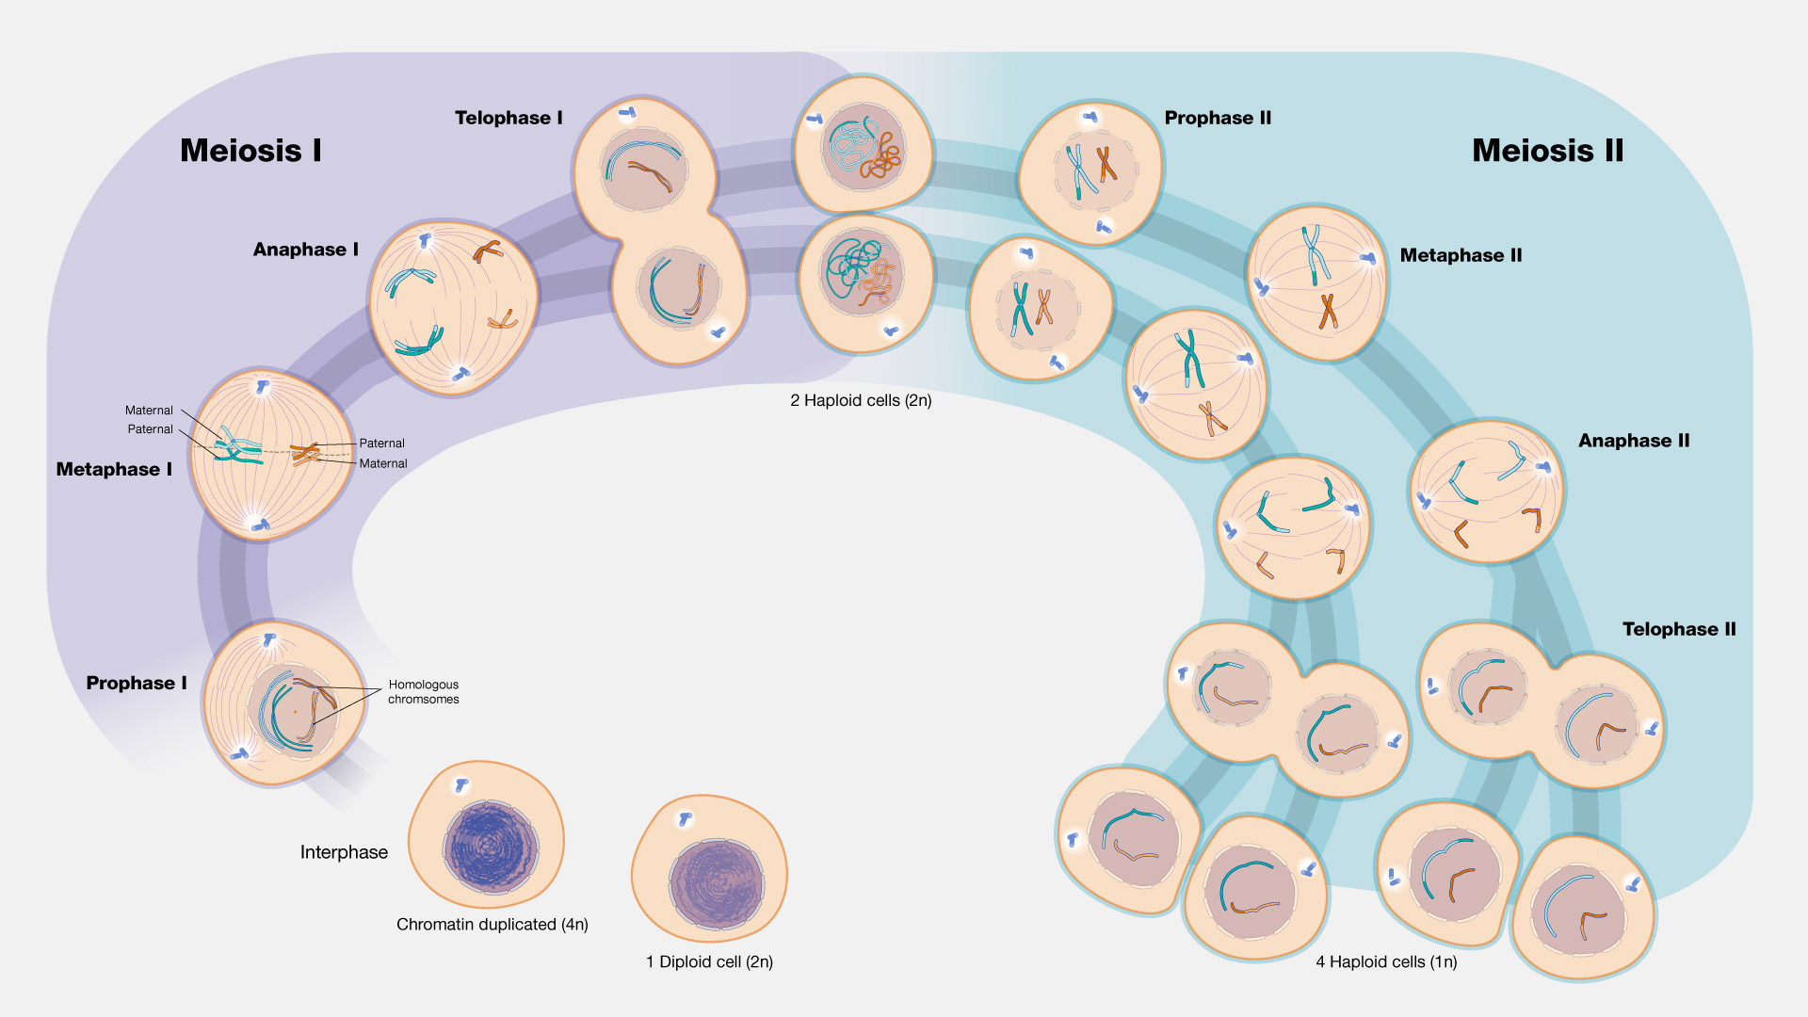
Meiosis – Duplication of Germ Cells

Slide 65
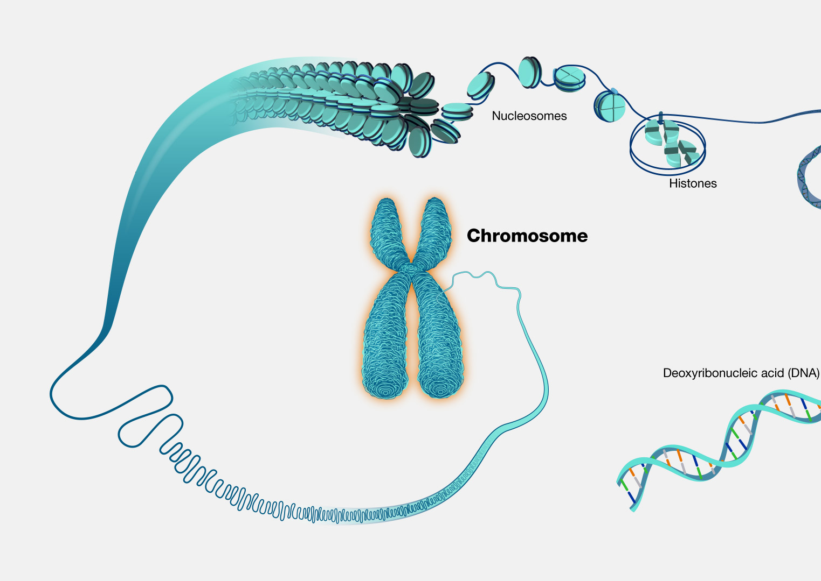
Chromosomes
Threadlike structures made of protein and a single molecule of DNA
Carry genomic information
Reside in the nucleus of cells
Humans have 22 pairs of numbered chromosomes (autosomes) and one pair of sex chromosomes (XX or XY), for a total of 46
Each pair contains two chromosomes, one coming from each parent or donor
Homologous chromosomes

Slide 66
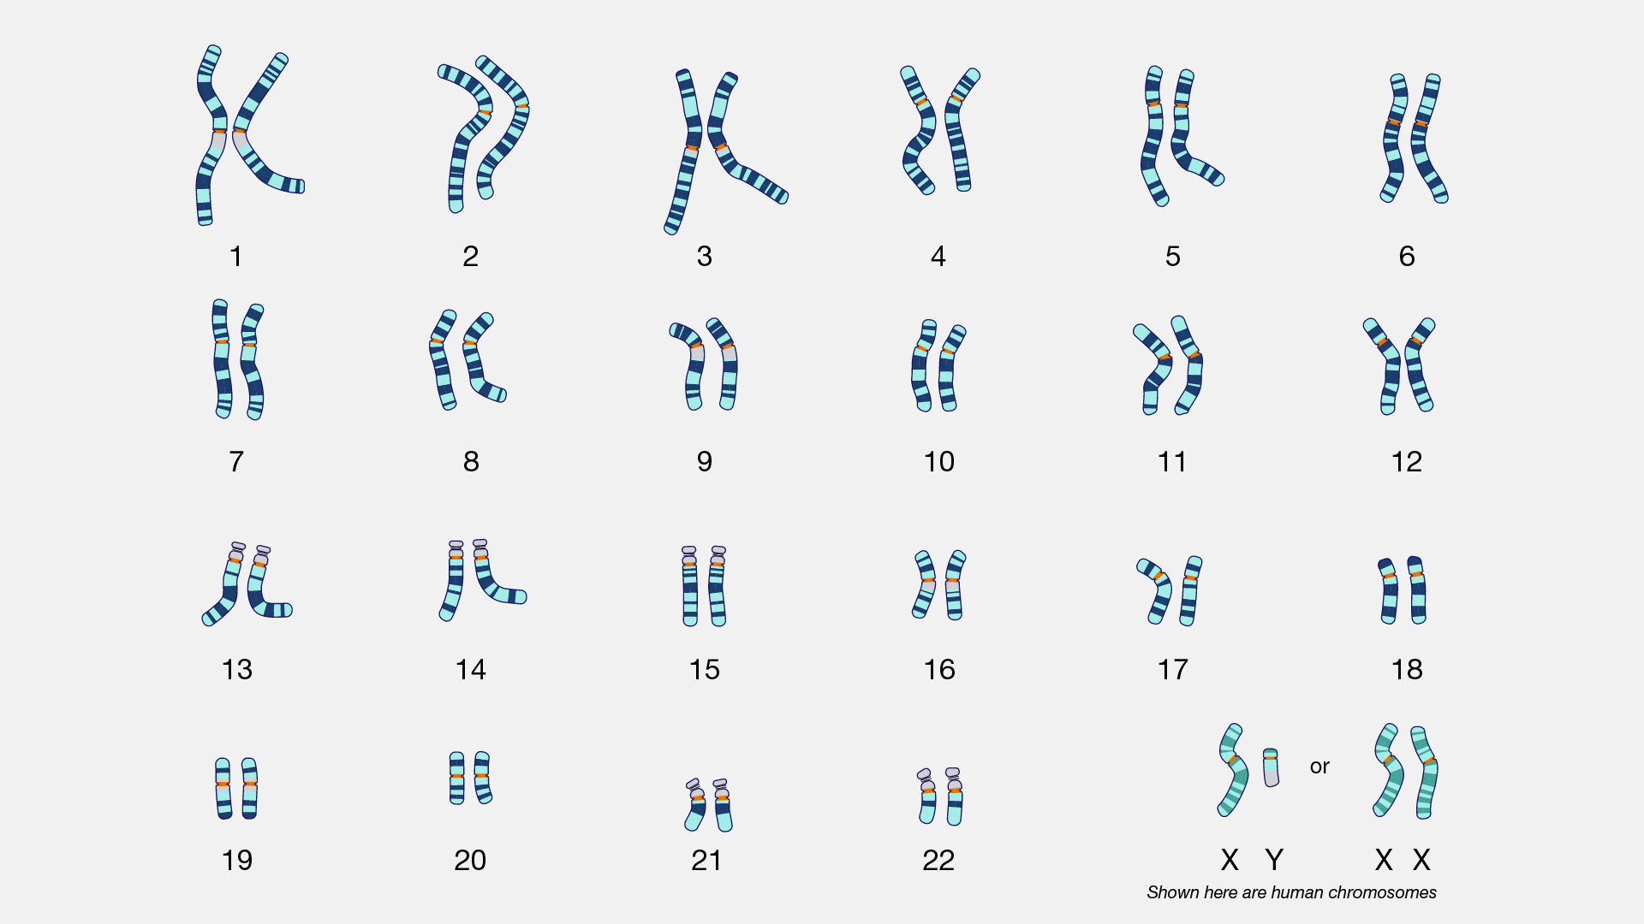
Chromosome Structure
Cytogenetics – study of structure and numeric characteristics of cell’s chromosome
Karyotype – image of individual’s chromosomes arranged in numerical order
Karyotyping Fun Fact: Colchicine is added to cells to arrest them in metaphase for better visualization of the chromosomes

Slide 67
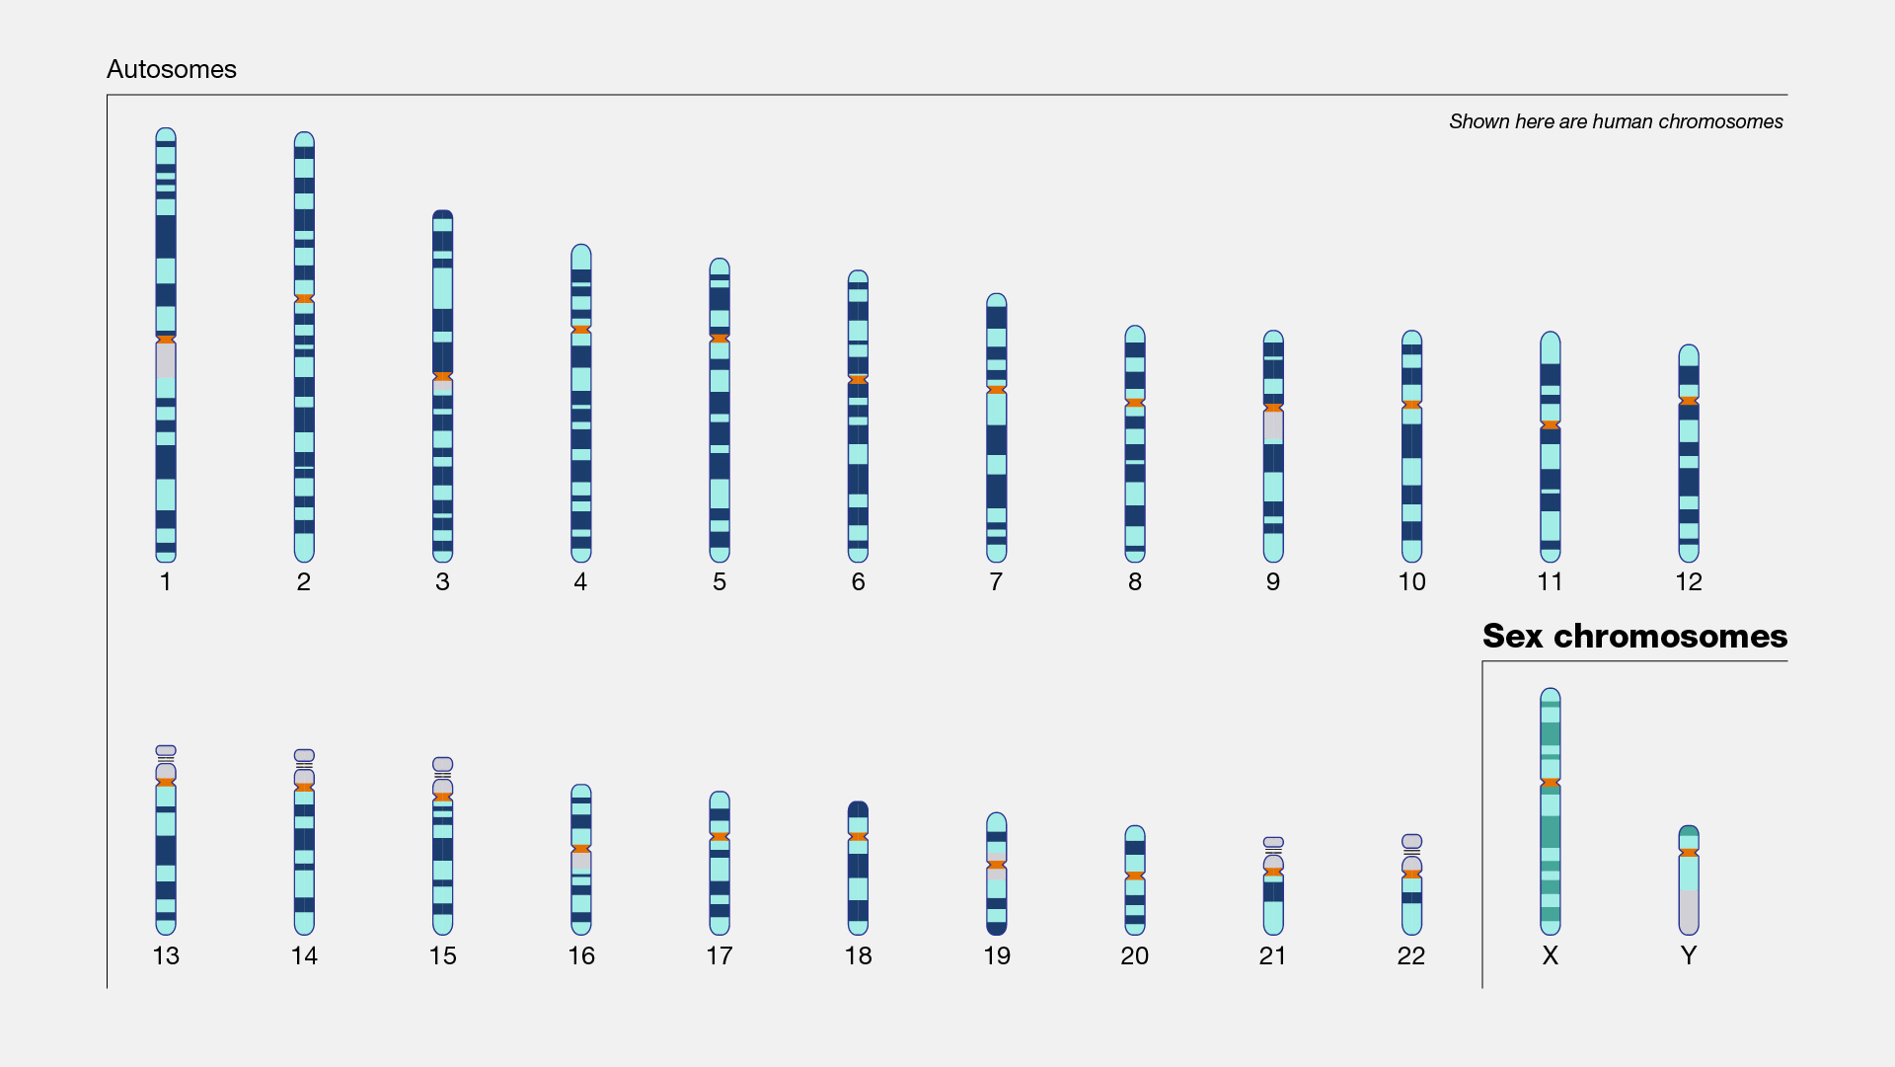

Slide 68
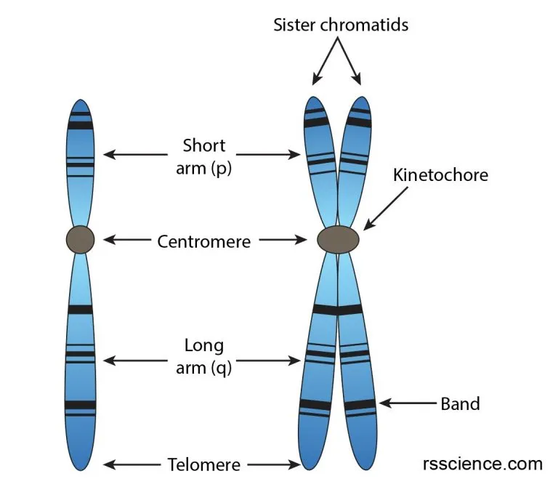
Chromosome Structure
Chromatids connected by centromere
2 arms – p and q
Telomeres – caps on end of chromosomes to ensure replication fidelity
Band – describes position on chromosome

Slide 69
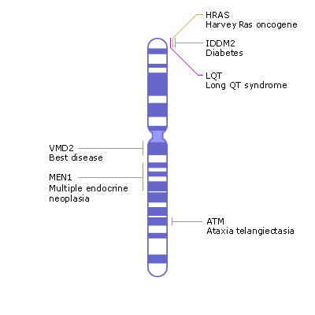
Chromosome Structure
Cytogenetic mapping – identification of gene location
Example: hemoglobin beta gene (HBB) is found on chromosome 11p15.4
The HBB gene lies on the short arm (p) of chromosome 11 and is found at the band labeled 15.4

Slide 70
Sex Chromosomes
Y chromosome determines male sex during embryonic development
X chromosome
Contains about 5% of a cell's total DNA and likely contains about 900 genes
For those with two X chromosomes (XX) – only one X is exp

Slide 71
Sex Chromosomes
Biologically female individuals have two X chromosomes (XX) while those who are biologically male have one X and one Y chromosome (XY) [There are exceptions]
Sex-linked patterns of inheritance differ by biological sex

Slide 72
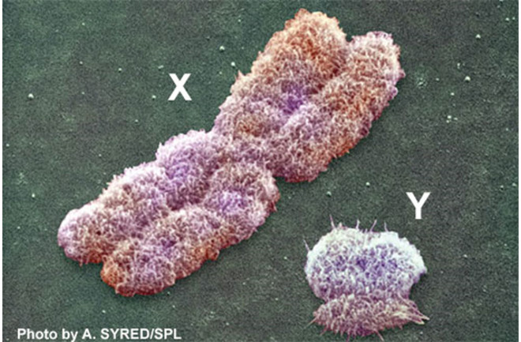
Sex Chromosomes
The X chromosome is about three times larger than the Y chromosome, containing about 900 genes, while the Y chromosome has about 55 genes

Slide 73
Sex Chromosomes – XX
Female mammals have two X chromosomes in every cell. One of the X chromosomes is inactivated.
This stops transcription from occurring, making sure a potentially toxic double dose of X-linked genes does not occur.
An inactivated X chromosome gets condensed into a small, dense structure in the nucleus, and is called a Barr body. Barr bodies are commonly used to determine sex.

Slide 74
Sex Chromosomes – XX
X chromosome inactivation is determined early in embryonic development.
Selection is random for each cell line
Tissues have on average 50% maternally derived and 50% paternally derived active X chromosomes
Lyon principle

Slide 75
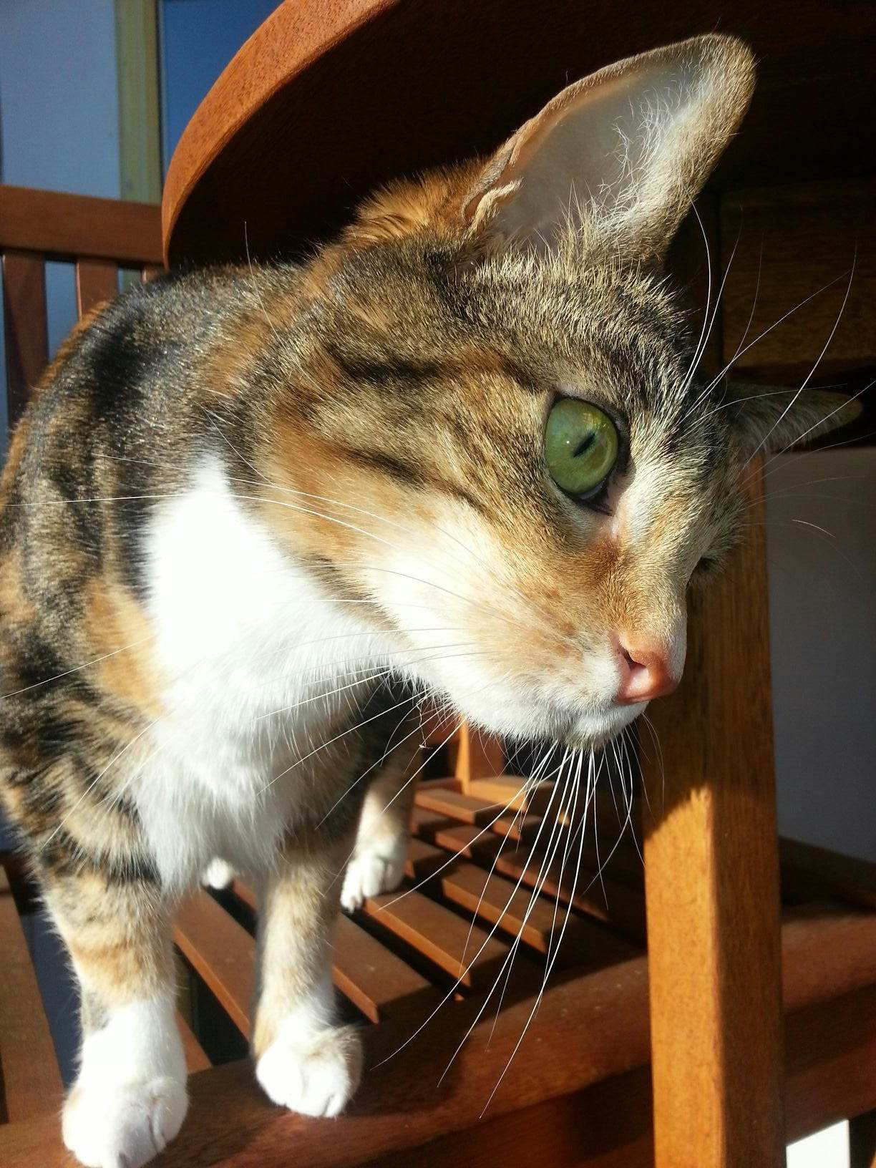
Sex Chromosome Fun Facts!
Some women have a rare super color vision trait called tetrachromacy, which is linked to the X chromosome. These women can see up to 100 million shades of color because they have four types of cone cells in their eye instead of the usual three.
Contrary to popular belief, calico is not a breed of cats, but rather a distinctive coat color pattern linked to the X chromosome. Over 95% of calico cats are female. The patches of fur on a calico cat are orange and black, and the color depends on which X chromosome is inactivated within each patch of color.

Slide 76
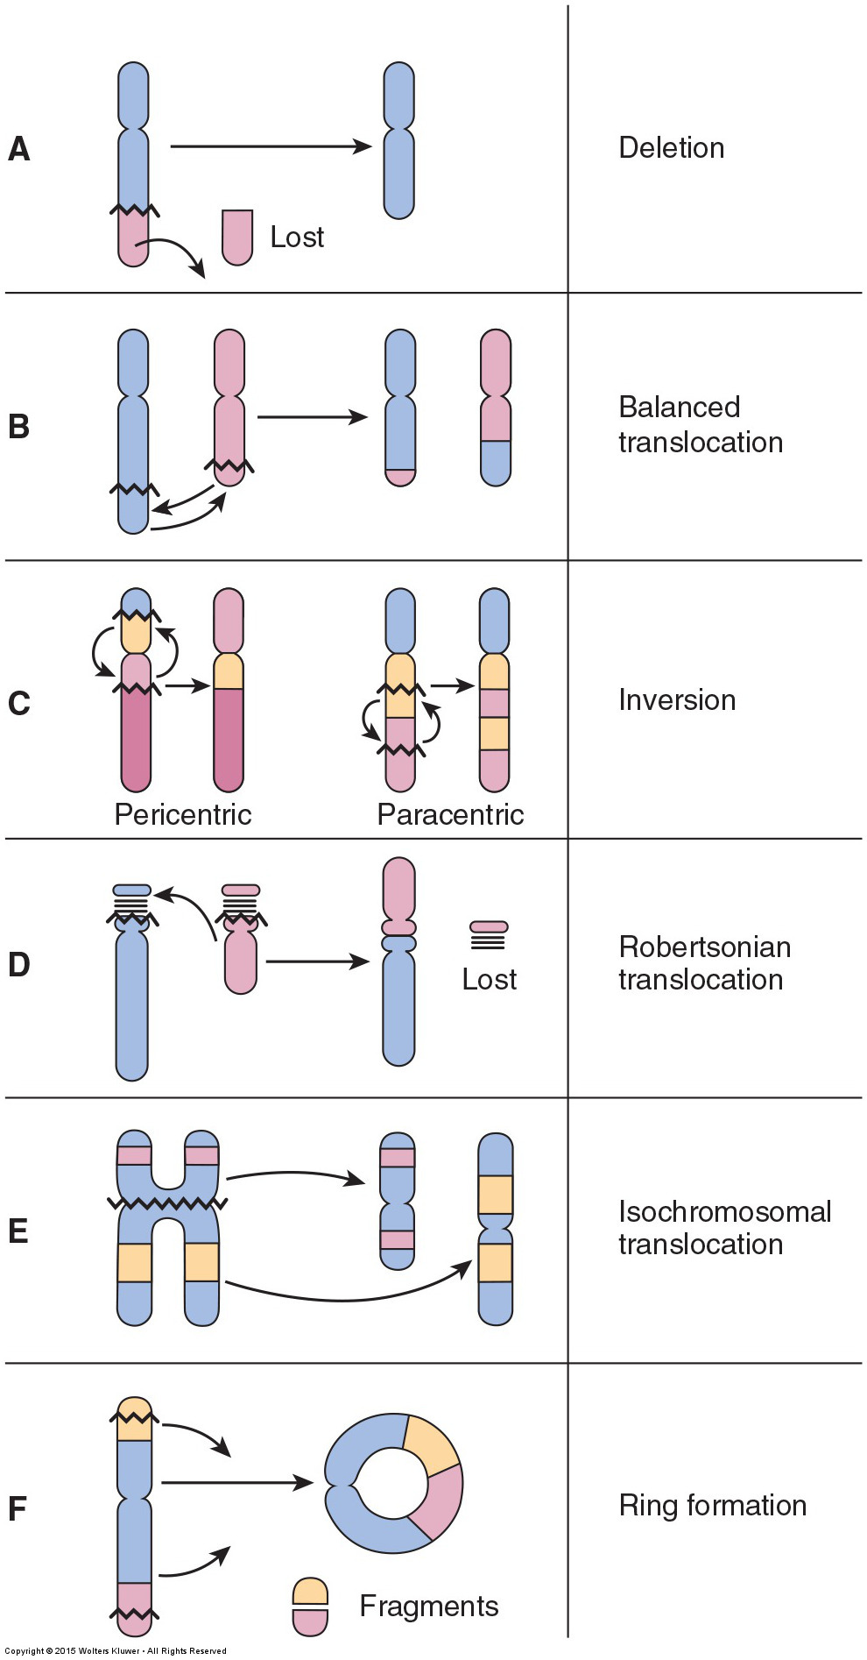
Chromosomal Disorders
Structural Chromosomal Abnormalities
Break in chromosome followed by rearrangement or deletion of parts
Numeric Autosomal
Numeric Sex Chromosome

Slide 77
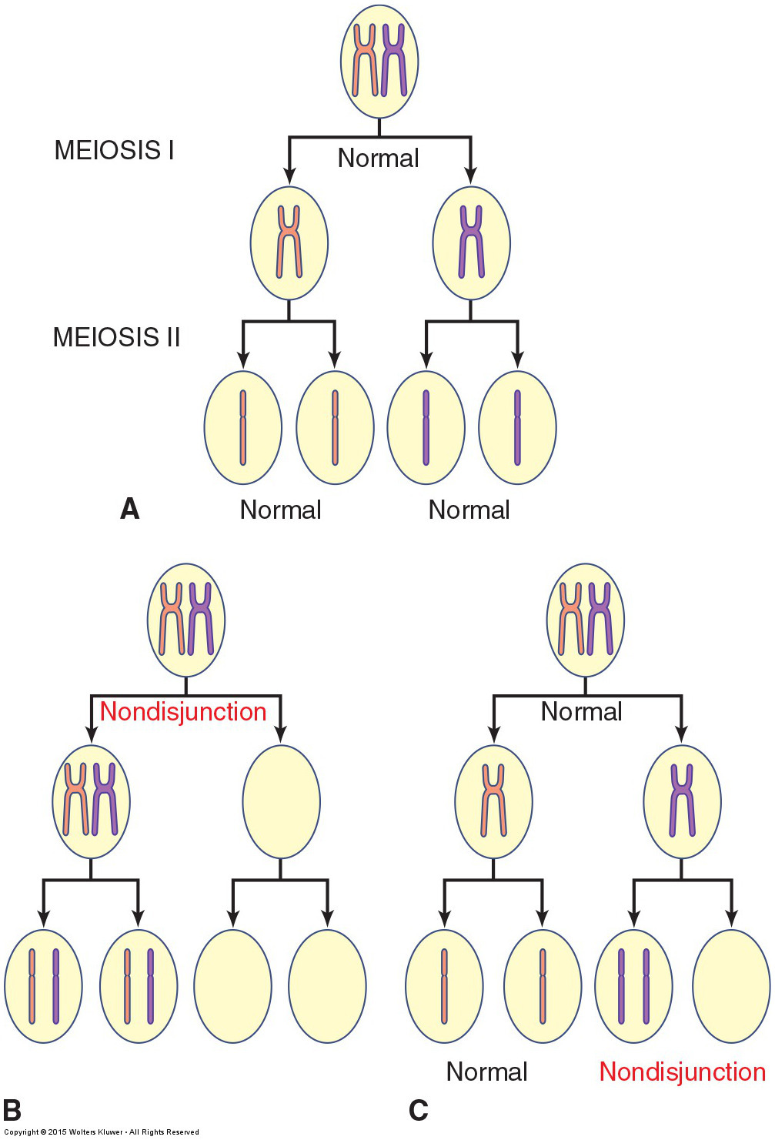
Chromosomal Disorders
Structural Chromosomal Abnormalities
Break in chromosome followed by rearrangement or deletion of parts
Numeric Autosomal
Change in chromosome number of autosome

Slide 78
Sex Chromosomes
Changes in the structure or number of sex chromosomes can lead to a number of diseases.
Trisomy X syndrome [XXX]
Turner syndrome [XO]
Klinefelter syndrome [XXY]

Slide 79
Notes:
Poll Title: Do not modify the notes in this section to avoid tampering with the Poll Everywhere activity. More info at polleverywhere.com/support Crossing-over of chromatid segments during meiosis division 1 results in: https://www.polleverywhere.com/multiple_choice_polls/LveMkDgWbDJy13aYz4SZi?display_state=instructions&activity_state=opened&state=opened&flow=Instructor&onscreen=persist

Slide 80
Notes:
Poll Title: Do not modify the notes in this section to avoid tampering with the Poll Everywhere activity. More info at polleverywhere.com/support Crossing-over of chromatid segments during meiosis division 1 results in: https://www.polleverywhere.com/multiple_choice_polls/LveMkDgWbDJy13aYz4SZi?display_state=chart&activity_state=closed&state=closed&flow=Instructor&onscreen=persist

Slide 81
Notes:
Poll Title: Do not modify the notes in this section to avoid tampering with the Poll Everywhere activity. More info at polleverywhere.com/support Crossing-over of chromatid segments during meiosis division 1 results in: https://www.polleverywhere.com/multiple_choice_polls/LveMkDgWbDJy13aYz4SZi?display_state=chart&activity_state=closed&display=correctness&state=closed&flow=Instructor&onscreen=persist

Slide 82
Notes:
Poll Title: Do not modify the notes in this section to avoid tampering with the Poll Everywhere activity. More info at polleverywhere.com/support A health care researcher has identified the gene of interest in a particular genetic disorder as well as the gene's location, Xq97. Where would one find a gene named Xq97? https://www.polleverywhere.com/multiple_choice_polls/enGqWAnMXbtIv84QUtWa2?display_state=instructions&activity_state=opened&state=opened&flow=Instructor&onscreen=persist

Slide 83
Notes:
Poll Title: Do not modify the notes in this section to avoid tampering with the Poll Everywhere activity. More info at polleverywhere.com/support A health care researcher has identified the gene of interest in a particular genetic disorder as well as the gene's location, Xq97. Where would one find a gene named Xq97? https://www.polleverywhere.com/multiple_choice_polls/enGqWAnMXbtIv84QUtWa2?display_state=chart&activity_state=closed&state=closed&flow=Instructor&onscreen=persist

Slide 84
Notes:
Poll Title: Do not modify the notes in this section to avoid tampering with the Poll Everywhere activity. More info at polleverywhere.com/support A health care researcher has identified the gene of interest in a particular genetic disorder as well as the gene's location, Xq97. Where would one find a gene named Xq97? https://www.polleverywhere.com/multiple_choice_polls/enGqWAnMXbtIv84QUtWa2?display_state=chart&activity_state=closed&display=correctness&state=closed&flow=Instructor&onscreen=persist

Slide 85
Patterns of Inheritance
Genotype: a person’s genetic material - DNA sequence and composition at a given locus
Phenotype: a person’s physical characteristics – appearance of a trait or expression of a disease
Expressivity: manner in which gene is expressed (mild <-> severe)
Penetrance: ability of a gene to express its function
Example – if 75% of people with a specific gene have the phenotype then penetrance is 75%
Locus: position of a gene on a chromosome

Slide 86
Gene Interactions
If only one pair of alleles (one gene) drive the trait: single-gene.
Many genes could affect one trait: polygenic.
Both multiple genes and the environment could affect one trait: multifactorial.*
One gene could mask the effect of another: epistasis.
One gene might depend on another: complementary.
Two genes together might create a new phenotype: collaborative.
If more than 1 allele affects same trait: multiple alleles.
*Most diseases fall into this category

Slide 87
Genetic Imprinting
Only one copy of a gene in an individual (one allele) is expressed, while the other copy is suppressed
Does not affect the DNA sequence itself

Slide 88
Genetic Imprinting
Only one copy of a gene in an individual (one allele) is expressed, while the other copy is suppressed
Does not affect the DNA sequence itself
Gene expression is silenced by the epigenetic addition of chemical tags to the DNA during egg or sperm formation

Slide 89
Genetic Imprinting
Only one copy of a gene in an individual (one allele) is expressed, while the other copy is suppressed
Does not affect the DNA sequence itself
Gene expression is silenced by the epigenetic addition of chemical tags to the DNA during egg or sperm formation
Epigenetic tags on imprinted genes usually stay in place for the life of the individual

Slide 90
Genomic Imprinting

Slide 91
Mendel Laws of Genetic Transmission
1865 – Gregor Mendel studied peas to determine patterns of inheritance of different phenotypes

Slide 92
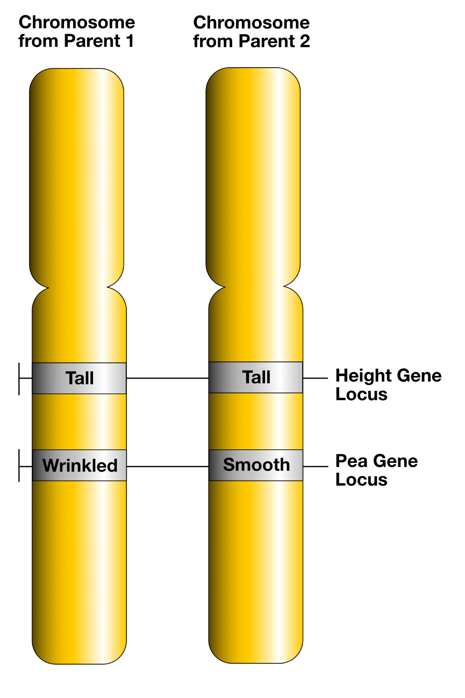
Alleles
same gene at same locus
homologous chromosomes (pair)
different sequence (classic definition)

Slide 93
Alleles Are Copies of a Gene
If all your copies of a gene are alike, you are homozygous.
AA or wnt/wnt
If they differ, you are heterozygous.
Aa
If you are heterozygous for a recessive trait and do not show it, you are a carrier.
Dominant genes – trait is expressed if homozygous or heterozygous
Recessive genes – trait is expressed if homozygous for recessive gene

Slide 94
Single Gene Disorders
Caused by a single gene variant
Gene variant → altered protein or decreased protein production
Follow Mendelian pattern of inheritance:
Autosomal dominant – Marfan syndrome, Huntington’s disease
Autosomal recessive – PKU, Tay-Sachs, sickle cell, cystic fibrosis
X-linked recessive – hemophilia A

Slide 95
X-linked Recessive Disorders
Females: XX – if heterozygous for trait will rarely have phenotype
Males: XY – only has one X chromosome, so all males affected
If mother has XX (carrier)
Daughters have 50% chance of being a carrier (XX)
Son has 50% chance of having disease (XY)
An affected male will give X gene to all of his daughters
Example – hemophilia A

Slide 96
X-linked Dominant Disorders
If XX – mutant X chromosome is dominant to normal X
Both sexes affected
But may be embryonic lethal for XY or homozygous for mutant X in some disorders
Affected females will transmit the mutant chromosome to 50% of offspring regardless of sex (remember – dominant mutation)
Affected males will have 100% affected daughters and 100% normal sons
Examples – Fragile X syndrome
Most common form on inherited intellectual disability
XY more severely affected than XX

Slide 97
Multifactorial Inheritance
Caused by multiple genes and environmental factors
There is an additive effect where some combination of genetic variants pushes one over the edge into a disease state
We don’t know what that is, but we are starting to discover allelic variants that increase disease risk
Example – cleft lip and cleft palate
Most chronic diseases fit into this category
Diabetes, cardiovascular disease, cancer

Slide 98
Discussion Questions:
A woman has just been diagnosed with breast cancer, a multifactorial disorder. Her doctor tells her that while cancer is a multifactorial disease, she carries the breast cancer susceptibility gene, BRCA1. One of her two identical twin 19-year-old daughters is afraid that she also may have inherited the gene.
a. What considerations would you give her daughter who is worried about inheriting the cancer gene?
b. What ethical issues are raised when one identical twin wants to know her genetic susceptibility to a disease and other does not?

Slide 99
Discussion Suggested Answers
Multifactorial inheritance demonstrates that multiple alleles at different loci affect the outcome. Multifactorial inheritance includes environmental effects on the genes. Although the daughter may have inherited the gene, she can still modify her chances of developing cancer by ensuring healthy lifestyle habits.
As an identical twin, if genetic information of one is learned, the other will also be known. The relationship between beneficence (do good), nonmaleficence (do no harm), and autonomy (the right to make your own decisions) as it relates to each identical twin.

Slide 100
Punnett Square: What Are the Odds?

Slide 101
Spiky hair gene (S):
Homer: HS
Marge: HS
What are their genotypes?
What are their phenotypes?
What are the genotypes and phenotypes of Bart, Lisa, and Maggie?
Is the spiky hair gene dominant or recessive?

Slide 102
Spiky hair gene (S):
Homer: HS
Marge: HS
What are their genotypes?
What are their phenotypes?
What are the genotypes and phenotypes of Bart, Lisa, and Maggie?
Is the spiky hair gene dominant or recessive?

Slide 103
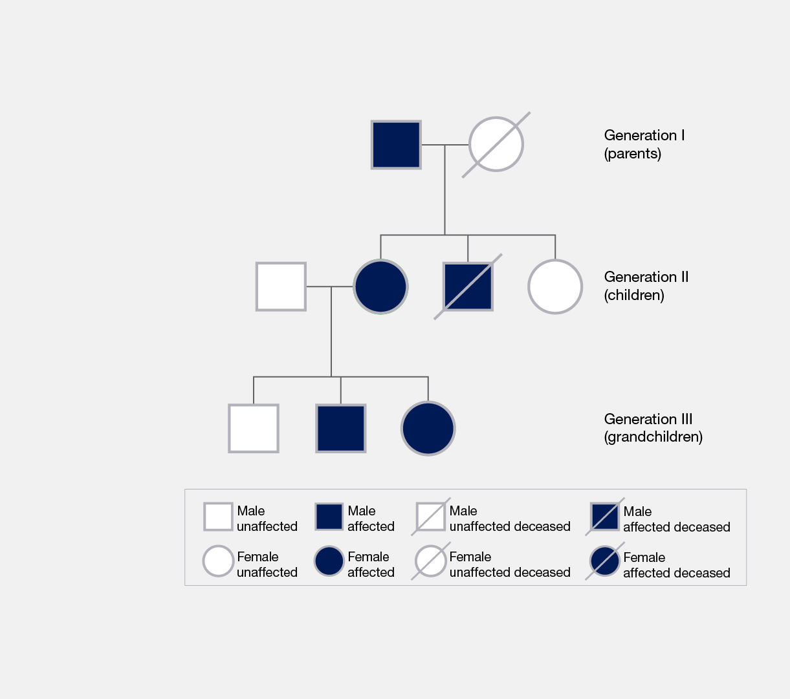
Pedigree
Chart that diagrams the inheritance of a trait or health condition through generations of a family

Slide 104
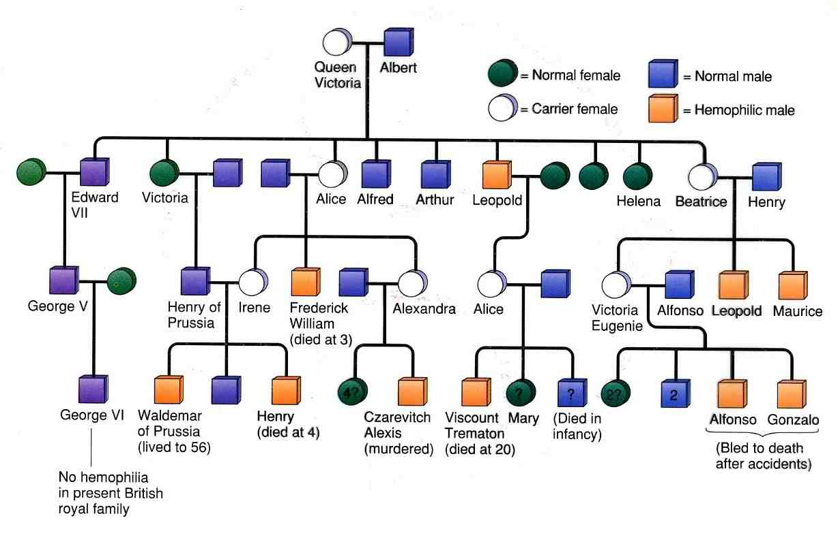

Slide 105
Notes:
Poll Title: Do not modify the notes in this section to avoid tampering with the Poll Everywhere activity. More info at polleverywhere.com/support The gene responsible for a particular congenital cardiac anomaly is said to have complete penetrance. What are the clinical implications of this fact? https://www.polleverywhere.com/multiple_choice_polls/CEh0qGinZEXiIDeUeFUms?display_state=instructions&activity_state=opened&state=opened&flow=Instructor&onscreen=persist

Slide 106
Notes:
Poll Title: Do not modify the notes in this section to avoid tampering with the Poll Everywhere activity. More info at polleverywhere.com/support The gene responsible for a particular congenital cardiac anomaly is said to have complete penetrance. What are the clinical implications of this fact? https://www.polleverywhere.com/multiple_choice_polls/CEh0qGinZEXiIDeUeFUms?display_state=chart&activity_state=closed&state=closed&flow=Instructor&onscreen=persist

Slide 107
Notes:
Poll Title: Do not modify the notes in this section to avoid tampering with the Poll Everywhere activity. More info at polleverywhere.com/support The gene responsible for a particular congenital cardiac anomaly is said to have complete penetrance. What are the clinical implications of this fact? https://www.polleverywhere.com/multiple_choice_polls/CEh0qGinZEXiIDeUeFUms?display_state=chart&activity_state=closed&display=correctness&state=closed&flow=Instructor&onscreen=persist

Slide 108
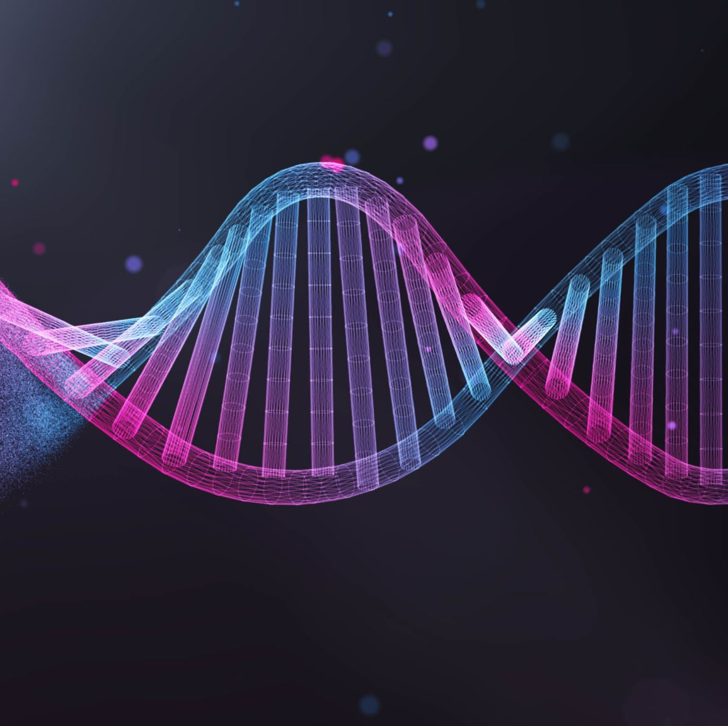
Gene Technology
Genetic mapping
Recombinant DNA Technology
RNA Interference Technology

Slide 109
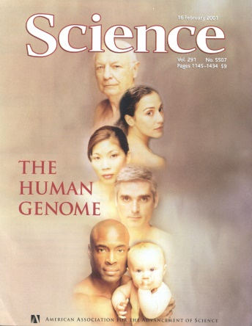
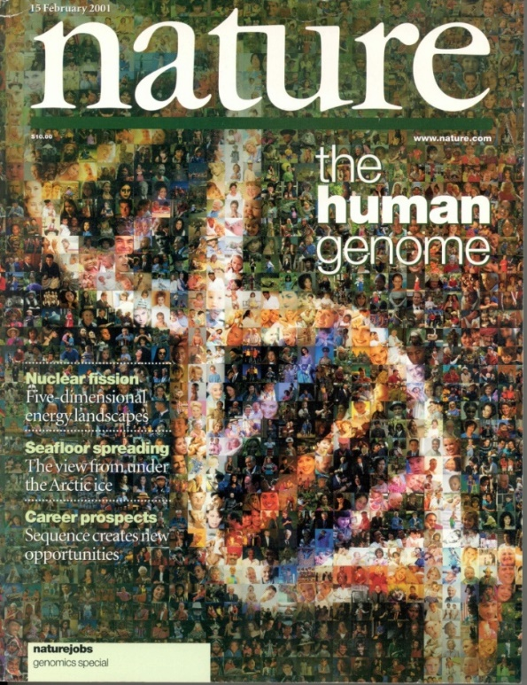
Genetic Mapping: Human Genome Project
The Human Genome Project began in 1990
2001 Rough Draft then in 2003 Completed sequence
It took 13 years and 3 billion dollars

Slide 110
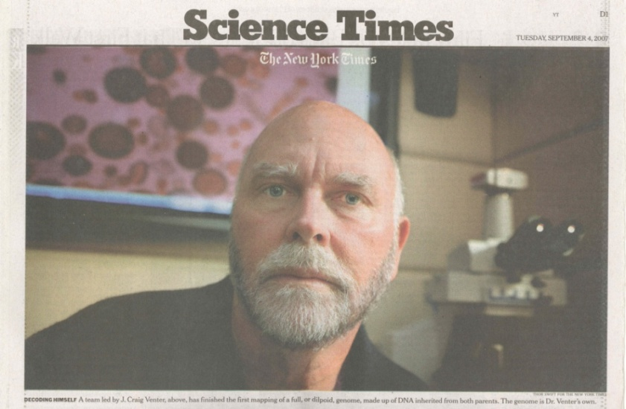
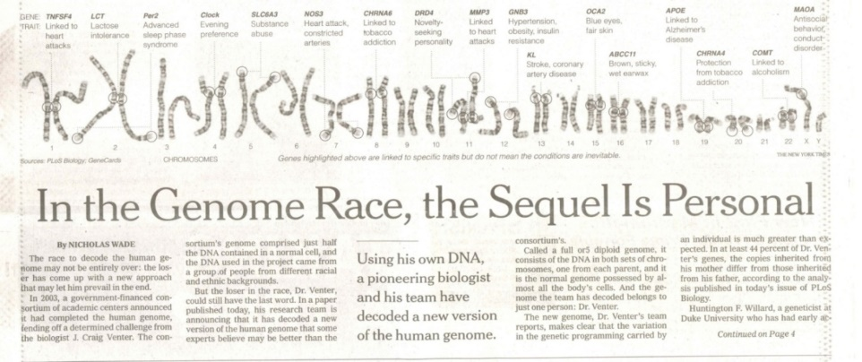
Advancements in Genome Sequencing
2007 - J. Craig Venter decoded a full diploid genome – his and James Watson’s
Took 3 months and $300,000 each
Currently it takes around 30 minutes and $600

Slide 111
Human Genome Project
The project goals were to:
identify all the approximately 30,000 genes in human DNA,
determine the sequences of the 3 billion chemical base pairs that make up human DNA,
store this information in databases,
improve tools for data analysis,
transfer related technologies to the private sector
address the ethical, legal, and social issues (ELSI) that may arise from the project.
2003 National Human Genome Research Institute (NHGRI) launched a public research consortium named ENCODE, the Encyclopedia Of DNA Elements

Slide 112
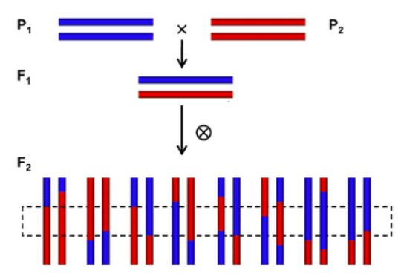
Genetic Mapping Methods: Linkage Studies
Linkage – the closeness of genes or other DNA sequences to one another on the same chromosome.
The closer two genes or sequences are to each other on a chromosome, the greater the probability that they will be inherited together

Slide 113
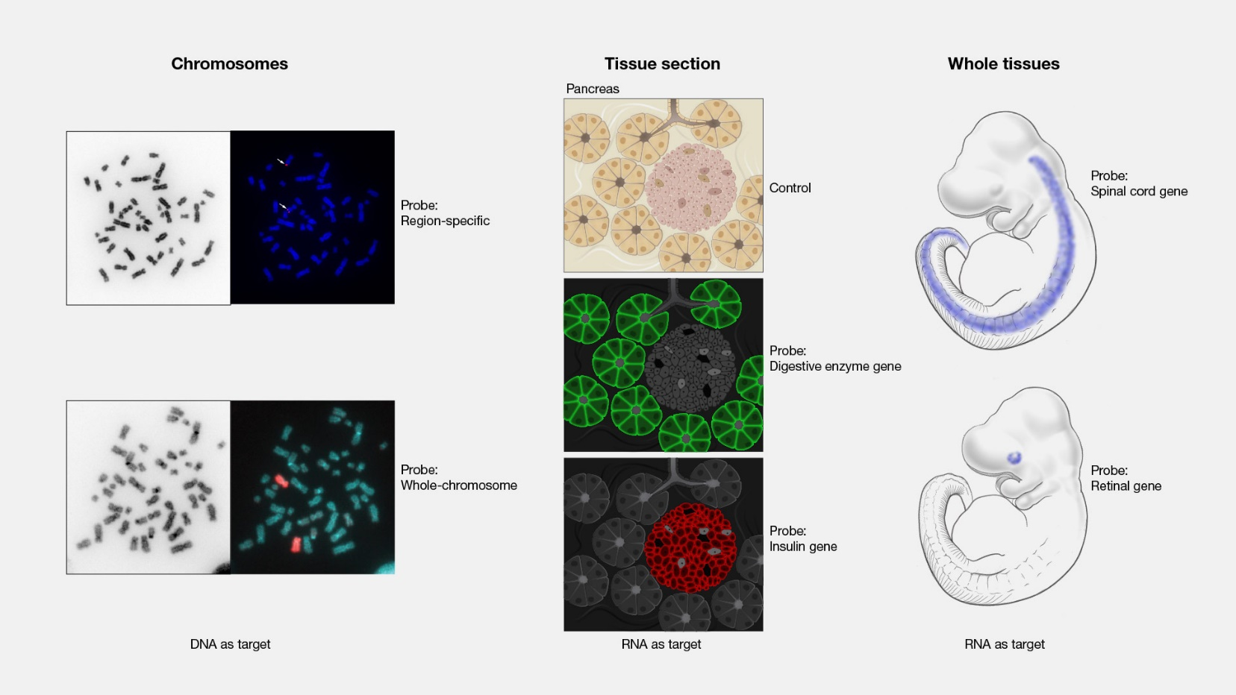
Genetic Mapping Methods: In Situ Hybridization
Laboratory technique used to localize a sequence of DNA or RNA in a biological sample.
Tissue sections, cells or chromosomes from an individual is affixed to a glass slide and then exposed to a “probe”—a small piece of single-stranded DNA tagged with a chemical or fluorescent dye.
The labeled probe finds and then binds to its matching sequence within the biological sample.

Slide 114
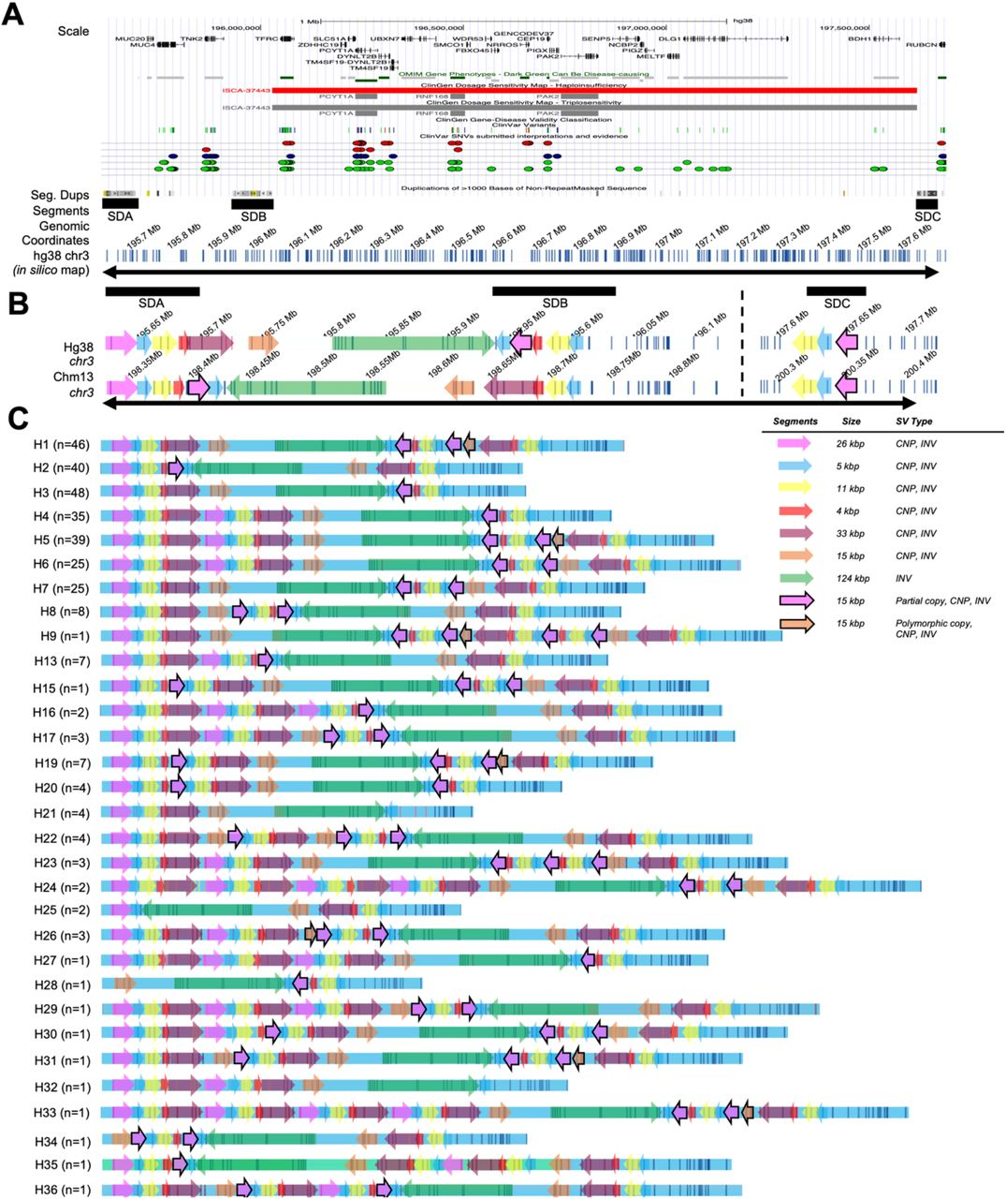
Haplotype Mapping
Haplotype – a physical grouping of genomic variants (polymorphisms) that tend to be inherited together
Typically reflects a unique combination of variants that reside near each other on a chromosome
Used to compare groups of people
Yilmaz F et al. medRxiv. 2021:2021.11.10.21266197. doi:10.1101/2021.11.10.21266197

Slide 115
Recombinant DNA Technology
Use of laboratory techniques to manipulate and isolate DNA segments of interest

Slide 116
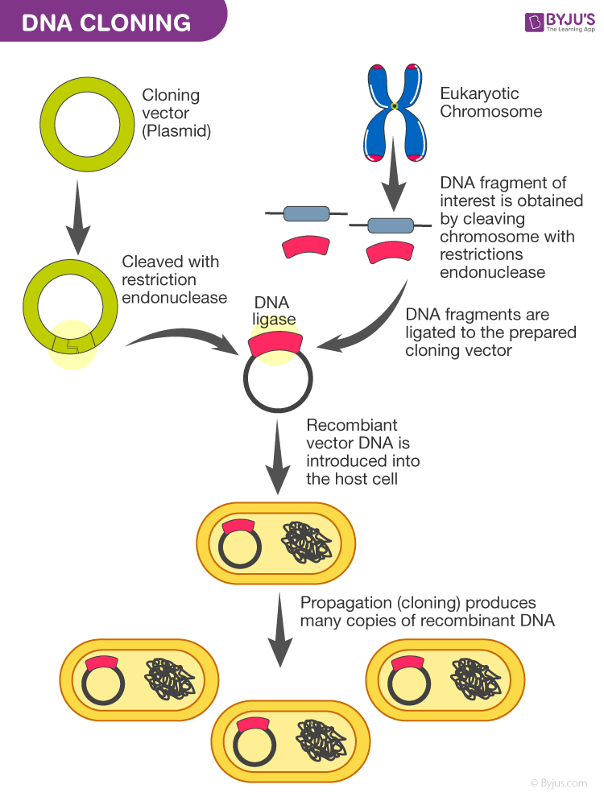
Recombinant DNA Technology: Gene Isolation and Cloning
DNA is easily isolated or extracted from cells using chemical processing
DNA is cleaved by a restriction enzyme
Recognize a DNA sequence (restriction site)
Cloning vectors are used to amplify DNA fragment
Contain plasmid (circular DNA)
DNA fragment and plasmid joined by DNA ligase
Recombinant DNA vector introduced to host cell and cultured

Slide 117
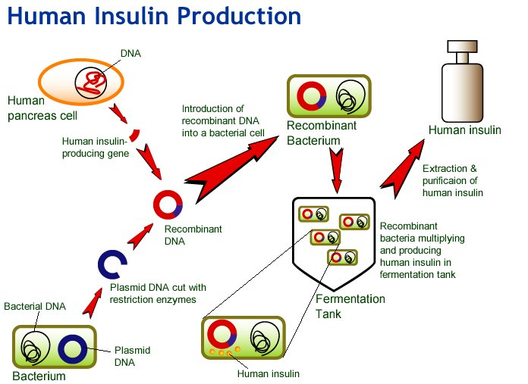
Recombinant DNA Technology: Pharmaceutical Applications
This is how insulin is made!
Other proteins:
human growth hormone
Erythropoietin
factor VII
TPA

Slide 118
Recombinant DNA Technology: DNA Fingerprinting
Used in forensic pathology

Slide 119
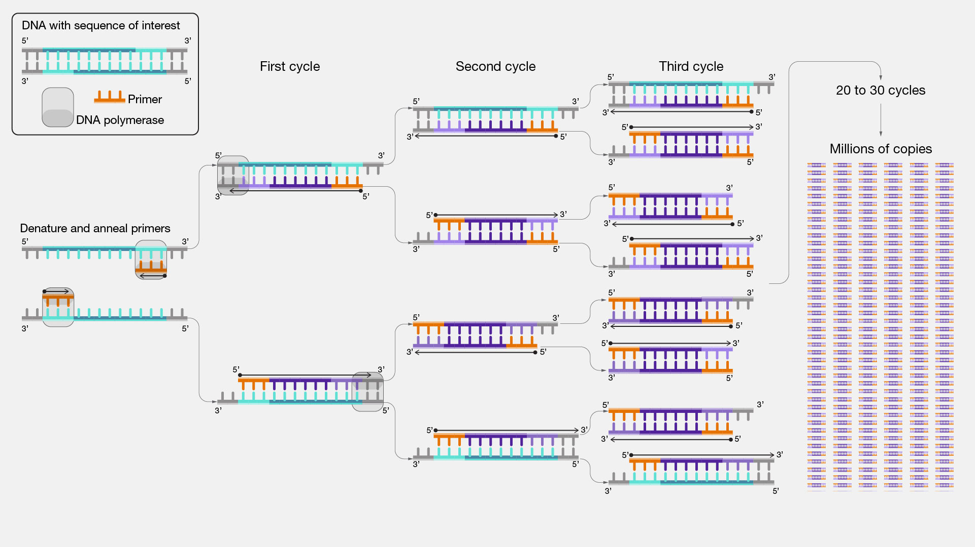
Recombinant DNA Technology: Polymerase Chain Reaction (PCR)

Slide 120
Recombinant DNA Technology: Gene Therapy
Using gene(s) to treat, prevent or cure a disease or medical disorder
Addition of new copies of a defective gene
Replacement of a defective or missing gene in a patient’s cells with a healthy version of that gene

Slide 121
RNA Interference Technology (RNAi)
Use of RNA molecules to turn off gene expression

Slide 122
Notes:
Poll Title: Do not modify the notes in this section to avoid tampering with the Poll Everywhere activity. More info at polleverywhere.com/support Which of the following facts underlies the application of RNA interference in the treatment of disease? https://www.polleverywhere.com/multiple_choice_polls/lUUngh48wQmrzm5Xwx27Y?display_state=instructions&activity_state=opened&state=opened&flow=Instructor&onscreen=persist

Slide 123
Notes:
Poll Title: Do not modify the notes in this section to avoid tampering with the Poll Everywhere activity. More info at polleverywhere.com/support Which of the following facts underlies the application of RNA interference in the treatment of disease? https://www.polleverywhere.com/multiple_choice_polls/lUUngh48wQmrzm5Xwx27Y?display_state=chart&activity_state=closed&state=closed&flow=Instructor&onscreen=persist

Slide 124
Notes:
Poll Title: Do not modify the notes in this section to avoid tampering with the Poll Everywhere activity. More info at polleverywhere.com/support Which of the following facts underlies the application of RNA interference in the treatment of disease? https://www.polleverywhere.com/multiple_choice_polls/lUUngh48wQmrzm5Xwx27Y?display_state=chart&activity_state=closed&display=correctness&state=closed&flow=Instructor&onscreen=persist

Slide 125
Notes:
Poll Title: Do not modify the notes in this section to avoid tampering with the Poll Everywhere activity. More info at polleverywhere.com/support The nursing faculty member is surprised to learn that bacteria are used when creating medications using recombinant DNA. How should the workshop leader explain the connection? https://www.polleverywhere.com/multiple_choice_polls/puQdIjfHQjug186OzJa8H?display_state=instructions&activity_state=opened&state=opened&flow=Instructor&onscreen=persist

Slide 126
Notes:
Poll Title: Do not modify the notes in this section to avoid tampering with the Poll Everywhere activity. More info at polleverywhere.com/support The nursing faculty member is surprised to learn that bacteria are used when creating medications using recombinant DNA. How should the workshop leader explain the connection? https://www.polleverywhere.com/multiple_choice_polls/puQdIjfHQjug186OzJa8H?display_state=chart&activity_state=closed&state=closed&flow=Instructor&onscreen=persist

Slide 127
Notes:
Poll Title: Do not modify the notes in this section to avoid tampering with the Poll Everywhere activity. More info at polleverywhere.com/support The nursing faculty member is surprised to learn that bacteria are used when creating medications using recombinant DNA. How should the workshop leader explain the connection? https://www.polleverywhere.com/multiple_choice_polls/puQdIjfHQjug186OzJa8H?display_state=chart&activity_state=closed&display=correctness&state=closed&flow=Instructor&onscreen=persist

